Slide 1
(NOTE: PASTE IN PORTRAIT AND SEND BEHIND FOREGROUND GRAPHIC FOR CROP)
Docker Practice in Alibaba Cloud
Yi Li
Alibaba Cloud Architect

Slide 2
Agenda
Cloud and Docker Status Update in China
Successful Stories
Aliyun Container Service
Dedicated Cloud Powered By Container
Scalable Docker Image Distribution

Slide 3
Alibaba Cloud: A Global Player for Cloud Computing
Russia
Europe
Japan
US West
CN North
CN East
US East
CN South
Middle East
Hong Kong
Singapore
Existed
Planned

Slide 4
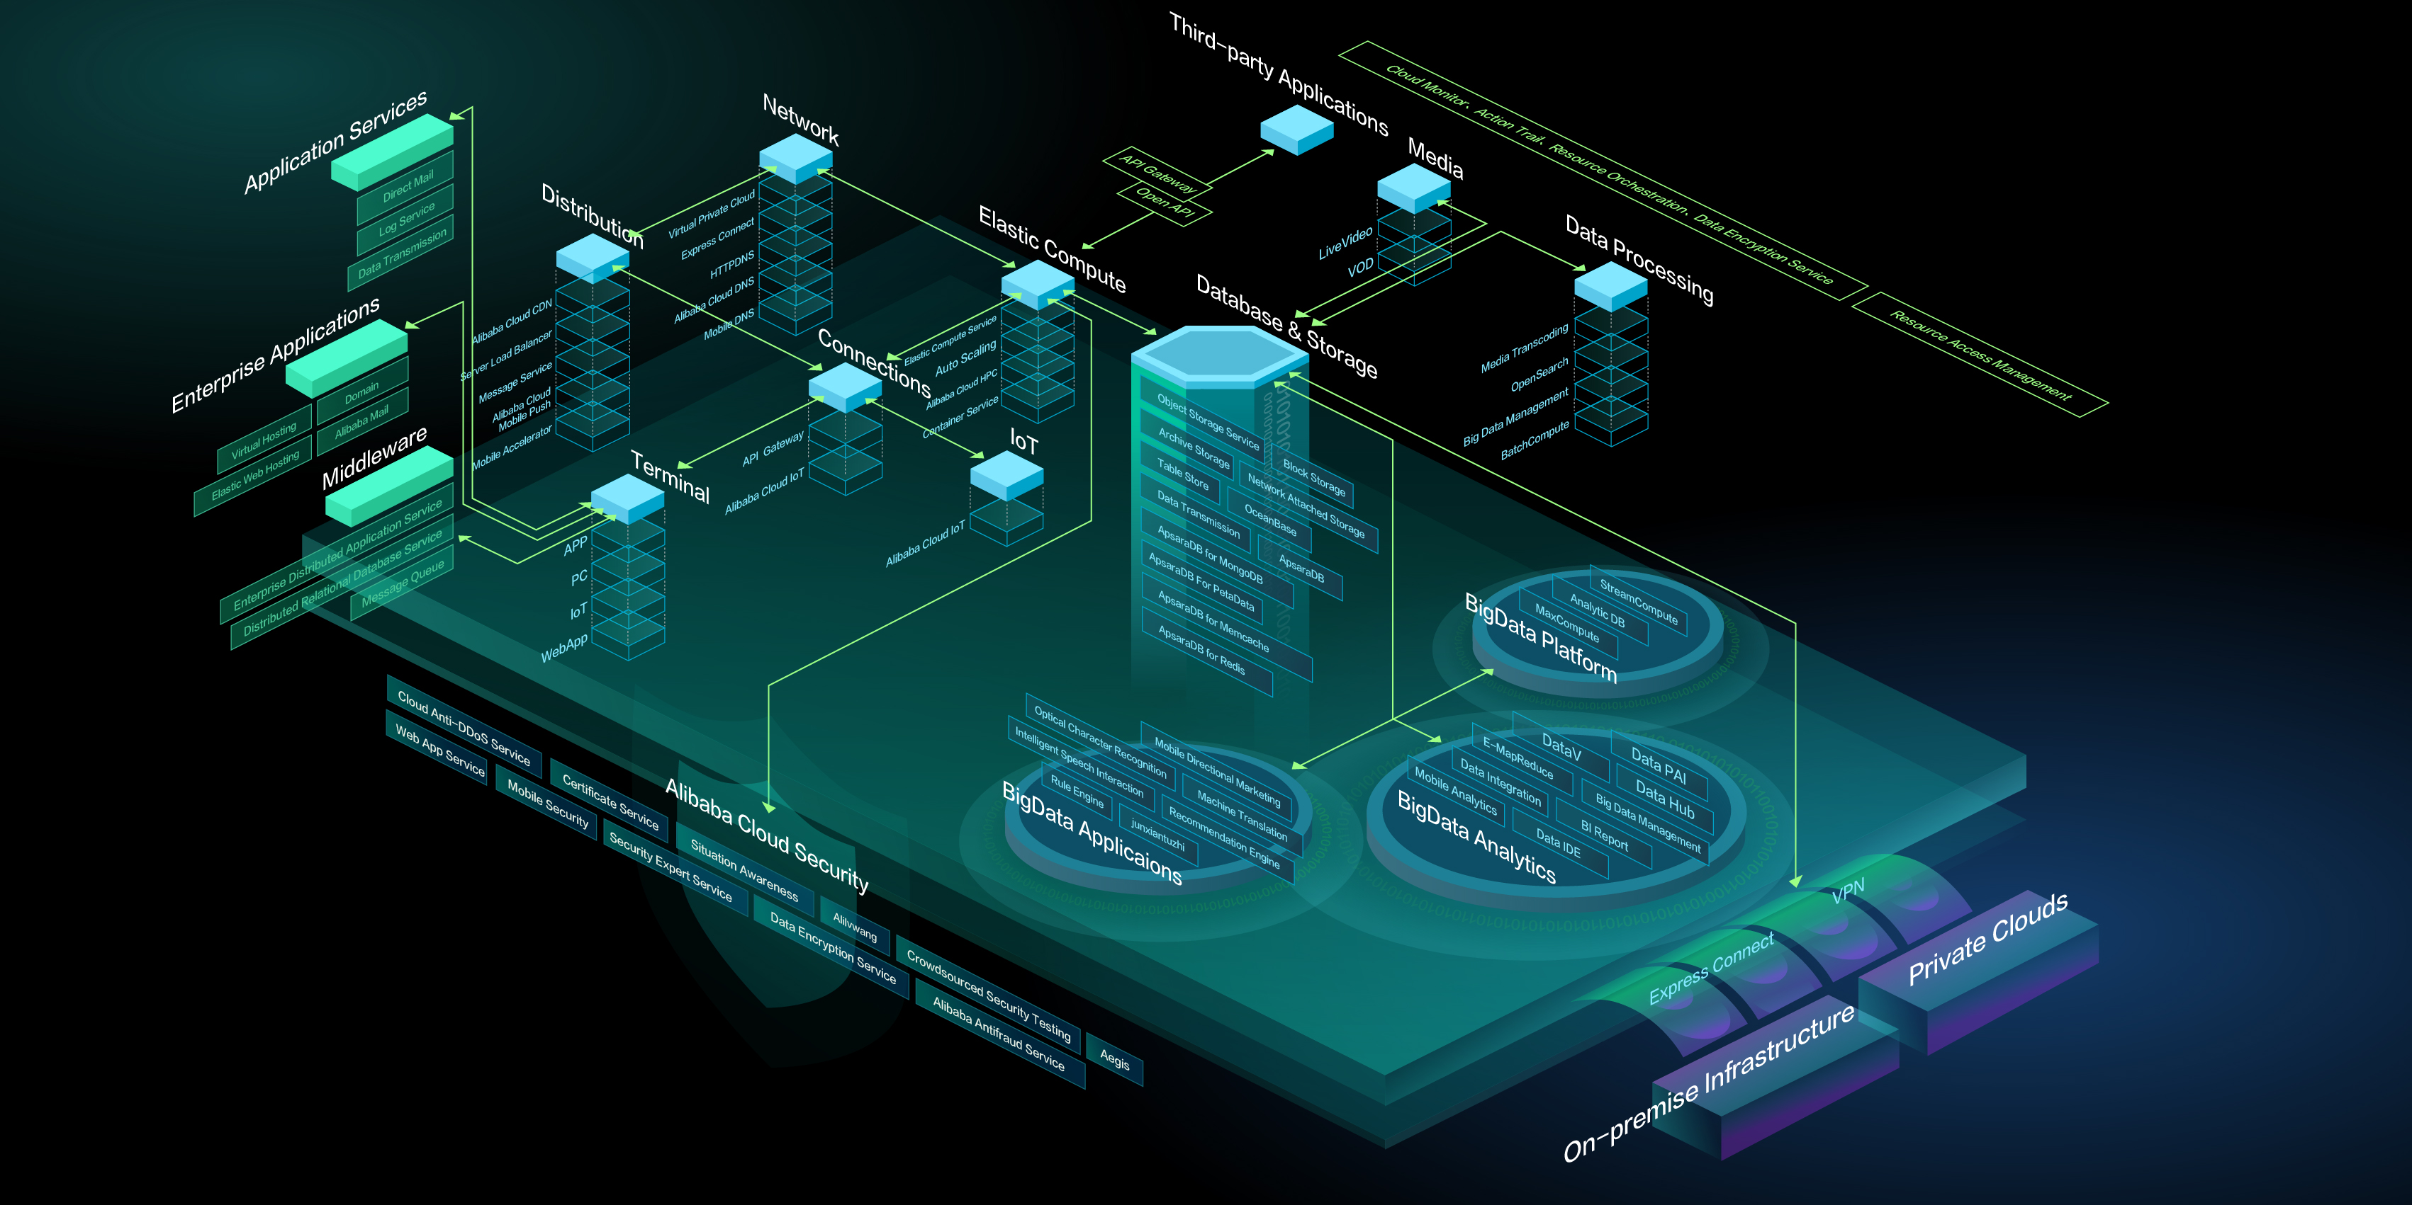
Alibaba Cloud: 93 Cloud Services Public Available

Slide 5
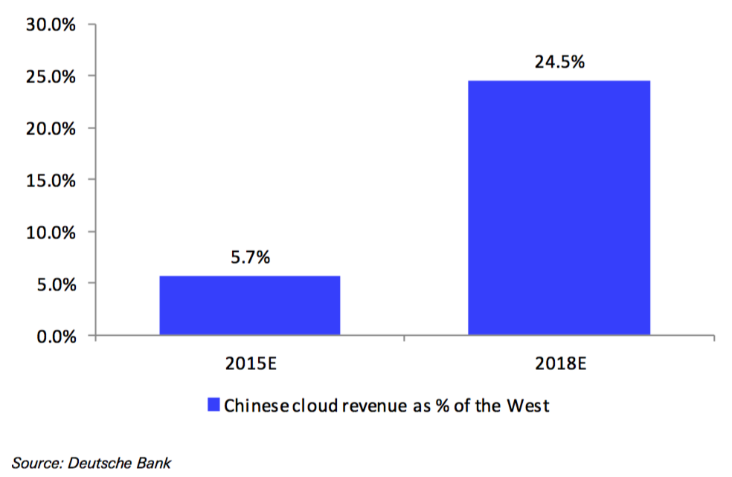
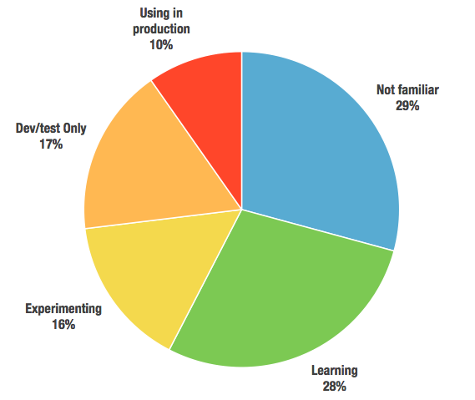
Cloud and Docker Status Update in China
China’s cloud spending to reach 24.5% of the West by 2018 from 5.7% in 2015
More than 80% respondents are already using or plan to use containers, but only 10% used in production environment.
China cloud relative to the West – DB
Docker Adoption in China
Survey result from 350+ feedbacks by Alibaba Cloud, June 2016

Slide 6
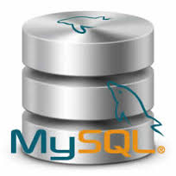
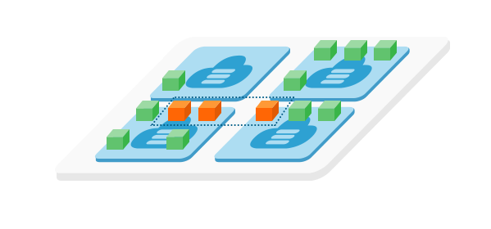
Aliyun Container Service From container to cloud native application
version: '2'
services:
wordpress:
image: wordpress:4.5
restart: always
links:
- 'db:mysql'
volumes:
- 'wp_upload:/var/www/html/wp-content/uploads'
environment:
- WORDPRESS_DB_USER=blog
- WORDPRESS_DB_PASSWORD=xxxxxx
- WORDPRESS_DB_NAME=wordpress
- availability:az==2
labels:
aliyun.probe.url: http://container
aliyun.routing.port_80: http://wordpress
aliyun.scale: '3'
aliyun.log_store_wordpress: stdout
db:
external:
host: rdsxxxxxx.mysql.rds.aliyuncs.com
ports:
- 3306
volumes:
wp_upload:
driver: ossfs
driver_opts:
bucket: acs-sample-wordpress
Fully compatible to Docker Compose/Swarm
http://wordpress.alicontainer.com
Load Balancing Service
AZ-a
AZ-b
OSSFS
OSSFS
OSSFS
One click to deploy in cloud
MySQL Instance from RDS
Bucket from
Object Store Service
Cluster of VM nodes

Slide 7
Aliyun Container Service From container to cloud native application
version: '2'
services:
wordpress:
image: wordpress:4.5
restart: always
links:
- 'db:mysql'
volumes:
- 'wp_upload:/var/www/html/wp-content/uploads'
environment:
- WORDPRESS_DB_USER=blog
- WORDPRESS_DB_PASSWORD=xxxxxx
- WORDPRESS_DB_NAME=wordpress
- availability:az==2
labels:
aliyun.probe.url: http://container
aliyun.routing.port_80: http://wordpress
aliyun.scale: '3'
aliyun.log_store_wordpress: stdout
db:
external:
host: rdsxxxxxx.mysql.rds.aliyuncs.com
ports:
- 3306
volumes:
wp_upload:
driver: ossfs
driver_opts:
bucket: acs-sample-wordpress
Fully compatible to Docker Compose/Swarm
Assemble the container and cloud services in declarative way
http://wordpress.alicontainer.com
Load Balancing Service
AZ-a
AZ-b
OSSFS
OSSFS
OSSFS
One click to deploy in cloud
MySQL Instance from RDS
Bucket from
Object Store Service
Cluster of VM nodes

Slide 8
Aliyun Container Service From container to cloud native application
version: '2'
services:
wordpress:
image: wordpress:4.5
restart: always
links:
- 'db:mysql'
volumes:
- 'wp_upload:/var/www/html/wp-content/uploads'
environment:
- WORDPRESS_DB_USER=blog
- WORDPRESS_DB_PASSWORD=xxxxxx
- WORDPRESS_DB_NAME=wordpress
- availability:az==2
labels:
aliyun.probe.url: http://container
aliyun.routing.port_80: http://wordpress
aliyun.scale: '3'
aliyun.log_store_wordpress: stdout
db:
external:
host: rdsxxxxxx.mysql.rds.aliyuncs.com
ports:
- 3306
volumes:
wp_upload:
driver: ossfs
driver_opts:
bucket: acs-sample-wordpress
Fully compatible to Docker Compose/Swarm
Assemble the container and cloud services in declarative way
Enable micro-service architecture
http://wordpress.alicontainer.com
Load Balancing Service
AZ-a
AZ-b
OSSFS
OSSFS
OSSFS
One click to deploy in cloud
MySQL Instance from RDS
Bucket from
Object Store Service
Cluster of VM nodes

Slide 9
Aliyun Container Service
DBaaS
MySQL,, Mongo …
Application
Application
Application
App
Logging
Caching Service
Load balancing, Routing
Access
Monitoring
Messaging Service
Service Registration, Discovery
Auto Scaling
Rolling update, A/B test, Canary …
Service
Access Control
Middleware
Services
Container Orchestration
Scheduling
Cluster Management
Orchestration
CI/CD
路由
Configuration Management
Docker Image
Compose template
Repository
Docker Engine
SCM
Container
3rd
Extensions
Storage
Block Storage, Network FS, Object Storage
Networking
Classic/VPC, Hybrid Cloud,
Extensions
Extensions
3rd
Extensions
Public Cloud
Dedicate Cloud
DevOps
Governance
Notes:
Optimize for application lifecycle in Cloud
Micro-service architecture
Orchestrate container and cloud services
Secure and controlled
DevOps by design

Slide 10
Aliyun Container Service
Integrates with cloud services
DevOps by design
Supports different workload
Web/Mobile, HPC, Event-driven, etc.
Secure, Controllable, and Extensible
DBaaS
MySQL,, Mongo …
Application
Application
Application
App
Logging
Enables micro-service architecture
Caching Service
Load balancing, Routing
Access
Monitoring
Messaging Service
Service Registration, Discovery
Auto Scaling
Rolling update, A/B test, Canary …
Service
Access Control
Middleware
Services
Container Orchestration
Scheduling
Cluster Management
Orchestration
CI/CD
路由
Configuration Management
Fully compatible to Docker ecosystem
Optimized volume/networking for Alibaba Cloud
Docker Image
Compose template
Repository
Docker Engine
SCM
Container
3rd
Extensions
Storage
Block Storage, Network FS, Object Storage
Networking
Classic/VPC, Hybrid Cloud,
Extensions
Extensions
3rd
Extensions
Public Cloud
Dedicate Cloud
DevOps
Governance
Notes:
Optimize for application lifecycle in Cloud
Micro-service architecture
Orchestrate container and cloud services
Secure and controlled
DevOps by design

Slide 11
Reference Customers and Partners

Slide 12
Apsara Stack- Full Stack Dedicated Cloud
Management and Operation
Open API (REST, SDK, Orchestration Template)
Enterprise Security Framework
Challenges
Deliver the full stack cloud efficiently
Minimize the resource overhead
HA and self-managed system
Continuing evolution
Big Data
Security Services
Application Services
Internet Scale Middleware Services
Elastic Compute
Storage Services
VPC
Database Services
Apsara Kernel : Unified, large scale, distributed computing framework
Distributed storage Service
Distributed resource management and scheduling
Distributed Coordination Service
Distributed Data Center Management
Customer-owned Infrastructure
100+ controller services developed by different teams
Each service has different dependencies of runtimes and libs

Slide 13
Deploy Dedicated Cloud in Few Person Days
Unified service description for all controller services
(In Docker Compose style format with extensions)
Docker Image
Registry
Deploy and configure service controllers as Docker containers
Capabilities (provides)
4
Service Controller
Container
X86 Server
Management
Agent
Service Controller
Container
Service Controller
Container
VXLAN/VLAN
Network Plugin
Probes
Healthy & monitoring
X86 Server
Image
Constrains
HA, placement, …
1
Docker Engine (Docker with Ali Extensions)
Data Center Management
Linux (AliOS)
Properties
X86 Server
Requirements (depends)
3
Clone the controller nodes from base OS image with Docker Engine
n + 1 hot backup
Recover node failure in minutes
Determine execution plan by resolving the dependencies among services automatically
Lookup configuration
2
S₁
S₂
Configuration Management
Management
Agent
Service Worker (Elastic Computing, Storage, Big Data, etc.)
S₃
S₄
X86 Server
X86 Server
Linux (AliOS)
S₇
5
X86 Server
S₅
S₆
Clone the worker nodes from base OS image, deploy and configure the service workers on baremetal
Notes:
Service Lifecycle: DB Init, DB upgrade, 幂等
Container Lifecycle
Service Healthy Check: Service Ready, Service Update
AG Container:
Standard for delivery and running
Placement: SSD, Affinity,
Failover:
Common Infrastructure Service: DNS, NTP, Yum， Clone
Admin Gatway
SLB, RDS, Monitoring, Storage, ECS, BigData
OSPF 10G Switch
100+ Services, 700+ Containers, 100 DB

Slide 14
Scalable Docker Image Distribution in Alibaba Group
Headquarter
CI/CD
Docker Registry with Index Server
OSS
Massive, secure and highly reliable object storage service
DC 1
Mirror
DC 2
Mirror
Other data centers in China and around the world …
OSS
OSS
10K+ servers concurrent pulling image within one Data Center
30% faster layer download through p2p distribution
Proxy with P2P
minion client
Proxy with P2P
minion client
Proxy with P2P
minion client
Proxy with P2P
minion client
Docker
tracker
Docker
Docker
tracker
Docker
Proxy with P2P
minion client
Proxy with P2P
minion client
Proxy with P2P
minion client
Proxy with P2P
minion client
Docker
Docker
Docker
Docker
Docker Engine enhanced with private registry mirror

Slide 15
Thank you!

