Slide 1
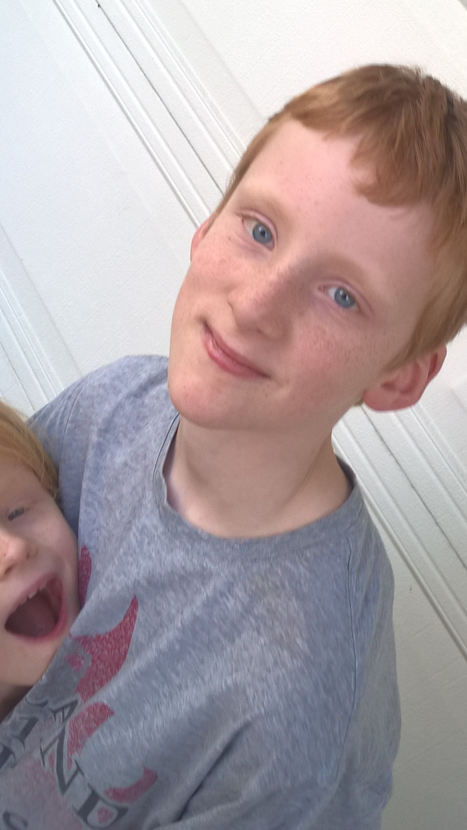
(NOTE: PASTE IN PORTRAIT AND SEND BEHIND FOREGROUND GRAPHIC FOR CROP)
So easy, a ten year old can do it
Zephaniah Gardler
Student
Notes:
Session Title: So easy, a ten year old can do it
Abstract: Docker focuses on simplicity. In this session we will hear how, Zeph, a 10 year old boy went from asking his dad a simple question, to deploying Docker containers to help search for a cancer cure and to build worlds. We’ll hear how the simplicity of Docker inspired him to learn more, and now as an 11 year old, he has moved on to programming his own containerized applications to process vital data streams from public APIs.
And the identified takeaways…
What are the key takeaways from your session? Docker is a great tool for enabling the learning of new IT skills
Intro + identify problem (dad complaining about stealing kills)
Demo: show basic stats and lack of detail
Researched Halo API
Demo: Programming in python to querry HaloAPI
Doing API querry
Parsing data and display
Realized he could put feed into container and display
Possibly fork data for inflated stats
Demo: webpage in container taking feed
Lesson learned and shared:
How to querry API and parse data to show it as a feed in container.

Slide 2
Intro
Zephaniah (Zeph) Gardler!
Geek
Likes video games
Inspired by awesome dad
Notes:
Docker focuses on simplicity. In this session we will hear how, Zeph, a 10 year old boy went from asking his dad a simple question, to deploying Docker containers to help search for a cancer cure and to build worlds. We’ll hear how the simplicity of Docker inspired him to learn more, and now as an 11 year old, he has moved on to programming his own containerized applications to process vital data streams from public APIs.

Slide 3
In this session
Docker is an inspiration
Docker is an enabler
Docker is a learning tool

Slide 4
Why is this important?
“On-boarding new hires is expensive” (according to my Dad)

Slide 5
Docker as an Inspiration

Slide 6
Being inspired
Introduced to programming because of cool projects like Folding At Home
Dockerizing the search for a Cancer cure
Docker Machine made it easy to set up and run Docker
So I helped cure cancer
Blogged on the Folding At Home project
Work was retweeted by Solemon Hykes
Notes:
from asking his dad a simple question, to deploying Docker containers to help search for a cancer cure and to build worlds.

Slide 7
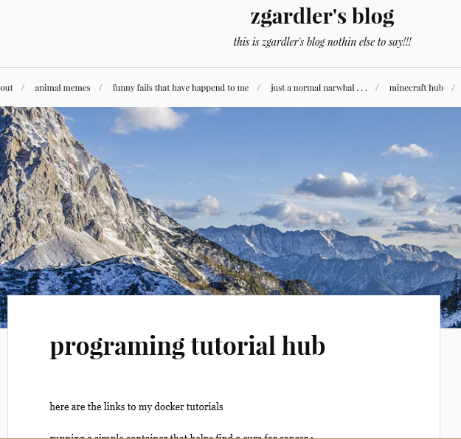
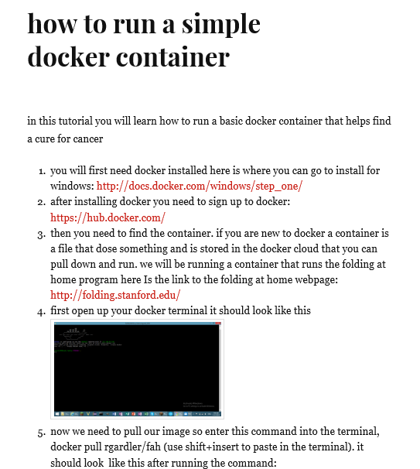
Notes:
My blog

Slide 8
Development kickstart
Install Docker for Windows
Dockerfile
FROM python:3
CMD [ "python", “hello.py" ]
hello.py
print(“Hello world”)
docker build …
docker run …

Slide 9
Even more important problem ☺
We have an even bigger (sarcasm) problem
The Halo 5 after game stats aren’t good enough for my needs
Dad is always complaining I steal his kills
There is an API for halo 5 game stats
Notes:
identify problem (dad complaining about stealing kills)

Slide 10
Halo API, what is it?
Exposes lots of game stats
Can build apps to process stats
Like an assists vs. kills web app
Sounds interesting but how hard is it?
Never programmed aside from basic drag and drop environments
Notes:
We’ll hear how the simplicity of Docker inspired him to learn more, and now as an 11 year old, he has moved on to programming his own containerized applications to process vital data streams from public APIs.

Slide 11
Docker as an Enabler

Slide 12
The Idea: Pseudo code
server.py
Get weapon meta-data
Get player report for arena (Someoldcowdude)
HTML with Flask
Iterate over results
Get WEAPONID
Get name for weapon from meta-data(WEAPONID)
Display total kills with weapon

Slide 13
From idea to app
Docker keeps things moving

Slide 14
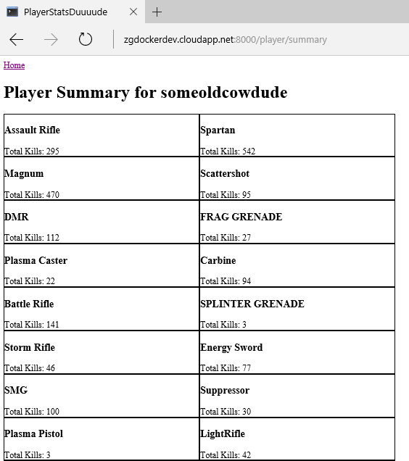
Demo: webpage in container taking feed
Public web page
http://zgdockerdev.cloudapp.net:8000/player/summary
Docker container running on Azure
Code on github
https://github.com/alivingmoobot/halostats

Slide 17
Docker as a Learning Tool

Slide 18
Lesson learned and shared:
Learned coding skills
Environment management with Docker
Deployment to the cloud (Azure)
Python including Flask
JSON
Concept of open source
Web page production / layout (HTML + CSS)
Emacs
TMux
The rapid iteration speed of Docker held my interest
Notes:
We’ll hear how the simplicity of Docker inspired him to learn more, and now as an 11 year old, he has moved on to programming his own containerized applications to process vital data streams from public APIs.

Slide 19
I, as an 11 year old, went quickly, how fast can your new hires go with Docker?

Slide 20
Docker is…
An inspiration
An enabler
A learning tool

Slide 21
100000 kills
911 headshots
Died 42 times with this weapon
3.14 hours held
Magnum
99.999999999999%
sniper
99.117 %
Smg
3.14159265%
Assault rifle
0.0000000000001%

