Slide 1
(NOTE: PASTE IN PORTRAIT AND SEND BEHIND FOREGROUND GRAPHIC FOR CROP)
Docker for Ops: Docker Networking Deep Dive
Madhu Venugopal
Jana Radhakrishnan

Slide 2
Agenda
Overview
What is libnetwork
New features in 1.12
Deep Dive
Multihost networking
Secure Control Plane
Secure Data plane
Service Discovery
Native Loadbalacing
Routing Mesh
Finish
Demo
Q&A

Slide 3
Overview

Slide 4
(NOTE: PASTE IN PHOTO AND SEND BEHIND FOREGROUND GRAPHIC FOR CROP)
What is libnetwork?
It is not just a driver interface
Docker networking fabric
Defines Container Networking Model
Provides builtin IP address management
Provides native multi-host networking
Provides native Service Discovery and Load Balancing
Allows for extensions by the ecosystem

Slide 5
(NOTE: PASTE IN PHOTO AND SEND BEHIND FOREGROUND GRAPHIC FOR CROP)
Multi-host
Networking without external k/v store
New features in 1.12 swarm mode
Cluster aware
De-centralized control plane
Highly scalable
Secure Control-Plane
Secure Data-Plane
CNM
Load Balancing
Service Discovery
Routing Mesh

Slide 6
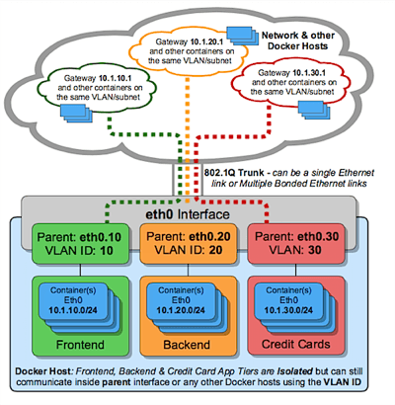
(NOTE: PASTE IN PHOTO AND SEND BEHIND FOREGROUND GRAPHIC FOR CROP)
Macvlan driver
Out of experimental
Integrates with Underlay
Place containers in your existing vlans

Slide 7
(NOTE: PASTE IN PHOTO AND SEND BEHIND FOREGROUND GRAPHIC FOR CROP)
MacVlan
# Create a macvlan network
$ docker network create -d macvlan \
--subnet=192.168.0.0/16 \
—-ip-range=192.168.41.0/24 \
--aux-address="favorite_ip_ever=192.168.41.2" \
--gateway=192.168.41.1 \
-o parent=eth0.41 macnet41
# First address is the specified gateway, second is aux
$ docker run --net=macnet41 -it --rm alpine /bin/sh

Slide 8
Deep Dive

Slide 9
(NOTE: PASTE IN PHOTO AND SEND BEHIND FOREGROUND GRAPHIC FOR CROP)
Multi-host networking
Service Create
Manager
The VXLAN based data path remains unchanged
No external key-value store necessary
Central resource allocation
Improved performance
Highly scalable
Orchestrator
Network Create
Task Create
Allocator
Scheduler
Dispatcher
Task Dispatch
Task Dispatch
Engine
Engine
Libnetwork
Libnetwork
Gossip
Worker1
Worker2

Slide 10
(NOTE: PASTE IN PHOTO AND SEND BEHIND FOREGROUND GRAPHIC FOR CROP)
Network control plane
Cluster Scope Gossip
Gossip based protocol
Network scoped
Fast convergence
Secure by default
periodic key rotations
swarm native key-exchange
Highly scalable
Network Scope Gossip
W1
W2
W3
W1
W5
W4
Network Scope Gossip

Slide 11
(NOTE: PASTE IN PHOTO AND SEND BEHIND FOREGROUND GRAPHIC FOR CROP)
Secure dataplane
Worker2
non-secure network
Available as an option during overlay network creation
Uses kernel IPSec modules
On-demand tunnel setup
Swarm native key-exchange
Periodic key rotations
Highly performant
Worker1
secure network
secure network
IPSec Tunnel
secure network
IPSec Tunnel
Open UDP traffic
IPSec Tunnel
secure network
non-secure network
Worker3

Slide 12
(NOTE: PASTE IN PHOTO AND SEND BEHIND FOREGROUND GRAPHIC FOR CROP)
Service Discovery
Provided by embedded DNS
Highly available
Uses Network Control Plane to learn state
Can be used to discover both tasks and services
DNS Resolver
DNS Resolver
DNS requests
DNS Server
engine

Slide 13
(NOTE: PASTE IN PHOTO AND SEND BEHIND FOREGROUND GRAPHIC FOR CROP)
Internal Load balancer
Task2 ServiceA
Task1
ServiceA
Task3 ServiceA
Provided by embedded DNS
Highly available
Uses Network Control Plane to learn state
Can be used to discover both tasks and services
Minimal Overhead because of CNM
Can use DNS RR instead as an option
Client1
Client2
VIP LB
VIP LB

Slide 14
(NOTE: PASTE IN PHOTO AND SEND BEHIND FOREGROUND GRAPHIC FOR CROP)
Routing mesh
External Loadbalancer (optional)
Builtin routing mesh for edge routing
Worker nodes themselves participate in ingress routing mesh
All worker nodes accept connection requests on PublishedPort
Port translation happens at the worker node
Same internal load balancing mechanism used to load balance external requests
8080
8080
Worker1
Worker2
8080->80
8080->80
VIP LB
VIP LB
Ingress Network
Task1 ServiceA
Task1 ServiceA
Task1 ServiceA

Slide 15
Finish
Demo and Q&A

Slide 16
Thank you!

