Slide 1
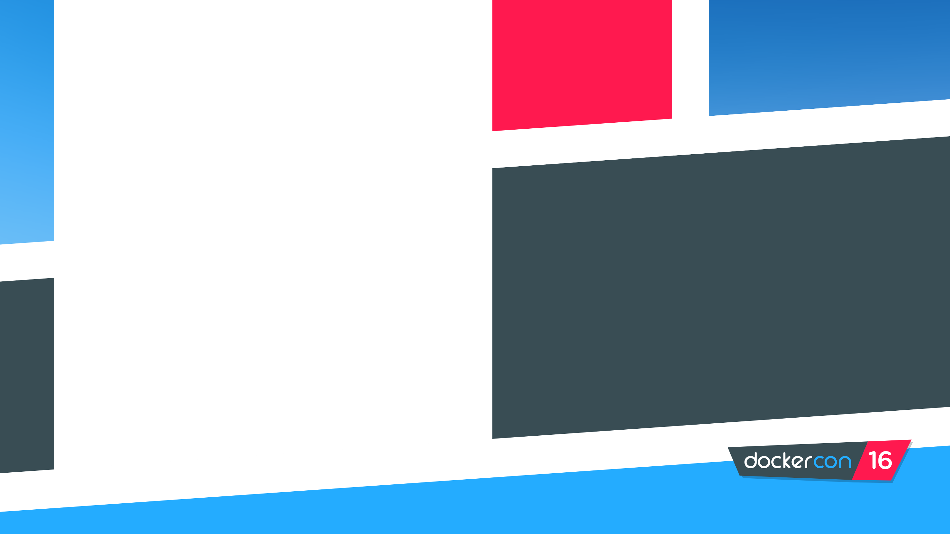
Vivek
Saraswat
Sr. Product Manager
@theVSaraswat
Docker for Ops: Operationalize Your Apps in Production
Evan
Hazlett
Sr. Software Engineer
@ehazlett

Slide 2
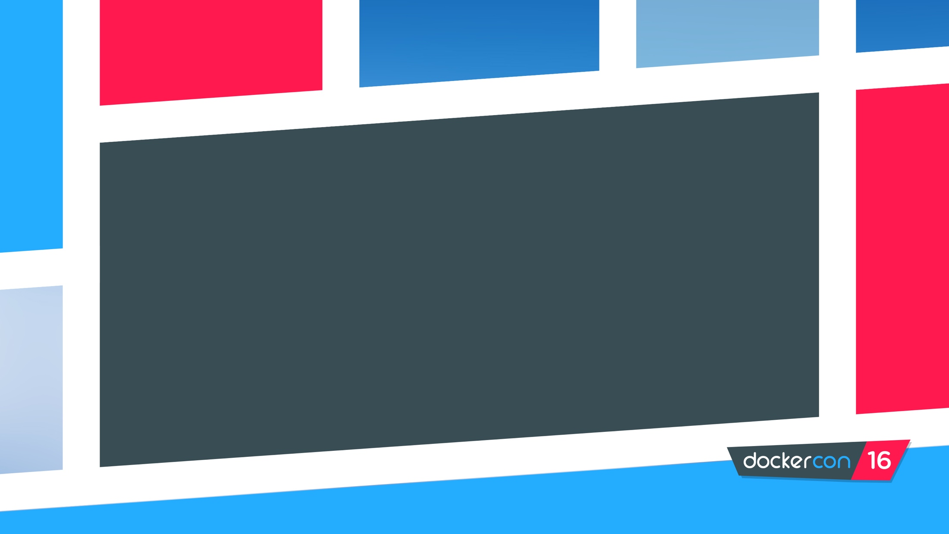
Agenda
Delivering Apps with Containers as a Service
Running a Docker App in Production
Putting in Practice (Docker Datacenter Demo)

Slide 3
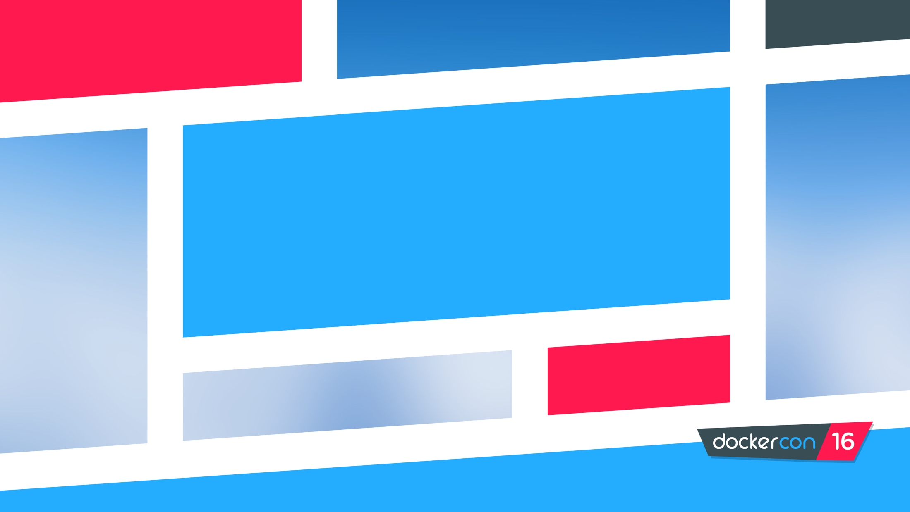
Delivering Apps with CaaS

Slide 4
What do Devs and IT Ops Want?
IT Operations
Faster, Easier App Development!
Standardized and Secure Workflows!
Must work everywhere!

Slide 5
What is Containers as a Service? (CaaS)
An IT Ops managed and secure environment for developers to self service build and deploy applications
How about in plain English?
Developers get the tools they want
IT gets secure and standardized workflows

Slide 6
So why use CaaS?
+
+
Agility
Portability
Control
Easy to setup and use
Native Docker solution
Extend developer experience
Consistent API
Seamless dev to prod workflow
Infrastructure, network and storage portability
Management at scale
Integrated content trust
Secure access control
Enterprise integrations
Notes:
The Docker CaaS platform delivers these benefits for organizations and is already proven by the thousands of organizations who embarked on the Docker journey starting in 2013
Agility – The speed and simplicity of Docker is what originally drew developers to Docker. They were fundamentally able to ship more software faster. This fundamentally changed the way in which companies could innovate
- ING went from shipping once every 9 months to shipping over 1,500 times a year by adoption Docker and DevOps
- CapitalOne was able to use Docker to transform how they use data to empower their data scientists and business decisions.
Portability – Just by the nature of the Docker technology, these developers realized they could easily move that containerized app from dev to test and ultimately to prod without any issue. No more finger pointing about why the app that worked fine in dev doesn’t work in prod. Having the app and dependencies packaged together made the container a self contained and independent unit. And beyond that, teams realized they could also move these apps across data centers and clouds – giving them a level of freedom and leverage not possible before. No more lock-in.
The combination of agility and portability led to the #1 most popular use case for Docker – Continuous Integration. But that’s only half the value. To realize the full value of Docker, these apps need to move to production and new requirements around manageability, security and monitoring are required to enforce SLAs.
Control – The Docker platform is the only solution that provides Agility AND Portability AND Control.
Docker standardizes your application environment, with native tooling to manage the infrastructure and applications. And we provide you the levers so YOU can decide how much control and freedom is appropriate for YOUR business. We don’t prescribe that for you. Our tools help unify your heterogeneous infrastructure, languages and systems.

Slide 7
How CaaS Works
DEVELOPERS
IT OPERATIONS
BUILD
Development Environments
SHIP
Secure Content & Collaboration
RUN
Deploy, Manage, Scale
Notes:
Local development environments
Self service app images
Build, Test, Deploy applications
Define app behavior and infra needs
Registry services for image storage, management and distribution
IT Ops maintains library of secure base content
Manage role based access to repos/images
Management consoles
Provision, manage infrastructure resources
Monitor, manage, scale infrastructure and applications

Slide 8

Docker Datacenter – CaaS for Enterprise
Operating Systems
CI/CD
Images
Networking
Volumes
Config Mgt
Monitoring
Logging
..more..
Docker Universal Control Plane
App and cluster management
Security
Content Trust, RBAC, LDAP/AD
Docker Trusted Registry
Image management and distribution
Docker Engine
Container runtime, orchestration, networking, volumes, plugins
Infrastructure
Public Cloud
Virtualization
Physical/Converged
Existing on prem infrastructure (e.g. RHEL/Ubuntu, Windows, ++)

Slide 9

Docker Datacenter – CaaS for Enterprise
Docker Interfaces
Docker Datacenter
Partner Integrations
Client
Docker Trusted Registry
Docker Universal Control Plane
Network
Plug-ins
Volume
Plug-ins
Compose
Monitoring
Logging
Content Security
Docker for Mac/Win
LDAP/ AD
Storage Drivers
Docker Swarm
Commercially supported Docker Engines
On premises Datacenter
Virtual Private Cloud

Slide 10
Running a Docker App in Production

Slide 11
Production App Considerations
Scale
Security
Monitoring
Ecosystem

Slide 12
Scale: Microservices Applications
Loosely coupled Services
Static Website
Analytics DB
User DB
Rapidly updated
Background Workers
Web Front End
Queue
API Endpoint
Development Test & QA Production Scale Out
Runs in multiple environments
Virtual machines
Disaster Recovery
Public Cloud
Server Cluster
Data Center
Developer Laptop
Server

Slide 13
Scale: Highly Available Infrastructure
External CA
LDAP/AD
Replicated UCP Config, State, CAs and Auth
across UCP Controllers
Replicated DTR Config, State, and CAs
across DTR Replicas
UCP Controller
UCP Controller
UCP Controller
DTR Replica
DTR Replica
DTR Replica
UCP Node
UCP Node
UCP Node
UCP Node
Notes:
Using DTR and UCP in production: Place controllers/replicas on separate hosts
Using DTR in production: Place controllers/replicas on same hosts

Slide 14
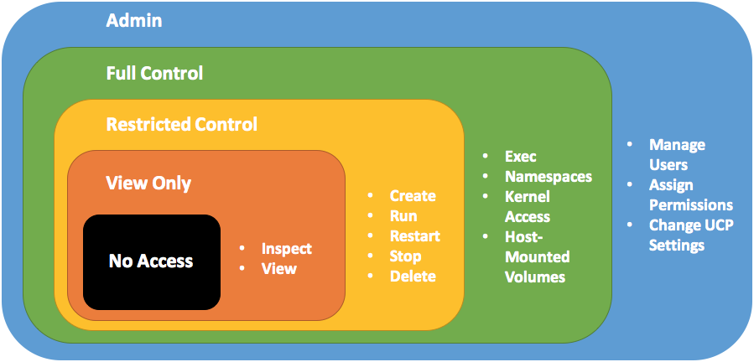
Security: Access Control
Authentication (AuthN)
Enterprise Integrations (e.g. LDAP/AD)
Users and Teams
Authorization (AuthZ)
Permissions
Labels

Slide 15
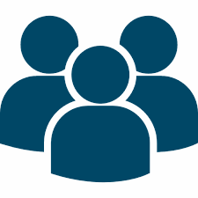
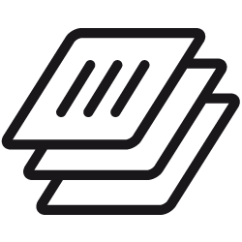






Security: Integrated Content Trust
Developers
IT Operations
BUILD
Development Environments
SHIP
Secure Content & Collaboration
RUN
Deploy, Manage, Scale
Developers self service from central library of trusted base images
IT maintains a central library of signed and scanned base images
Image signatures for publisher verification
Image scanning for vulnerability detection
…
Notes:
Local development environments
Self service app images
Build, Test, Deploy applications
Define app behavior and infra needs
Registry services for image storage, management and distribution
IT Ops maintains library of secure base content
Manage role based access to repos/images
Management consoles
Provision, manage infrastructure resources
Monitor, manage, scale infrastructure and applications

Slide 16
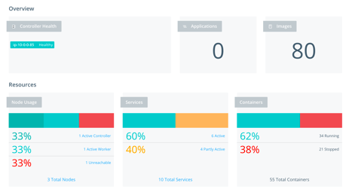
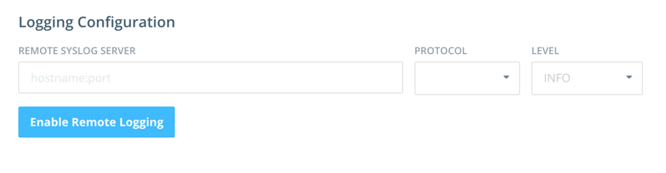
Monitoring: Analytics and Troubleshooting
Monitor cattle, not pets
  Distributed apps vs. single containers/hosts)
Built-in CaaS features for quick analysis
  Application statistics, Syslog integration
Build/Buy for sophisticated analysis
  OSS tools (Influx, Prometheus, etc.)
  Partner integrations (see next slide!)

Slide 17

Ecosystem: Technology Partner Integrations
Networking
Storage
Logging
Monitoring

Slide 18


It’s Demo Time!
~/src/docker/expressApp$ docker build -t chrisdias/expressapp
Sending build context to Docker daemon 72.18mb
Step 0 : FROM node:latest
–––> 8e20baae42c8
Step 1: COPY . /src
–––> 8e20baae42c8
Removing intermediate container afdcd49c779
Step 0 : FROM node:latest
–––> 8e20baae42c8
Step 1: COPY . /src
–––> 8e20baae42c

Slide 19
Get Started with Docker CaaS Solutions!
Learn More about Docker Datacenter: https://www.docker.com/products/docker-datacenter
Get a Trial or Purchase Docker Datacenter: https://store.docker.com
Come talk to us at the Docker Datacenter Booth!

Slide 20
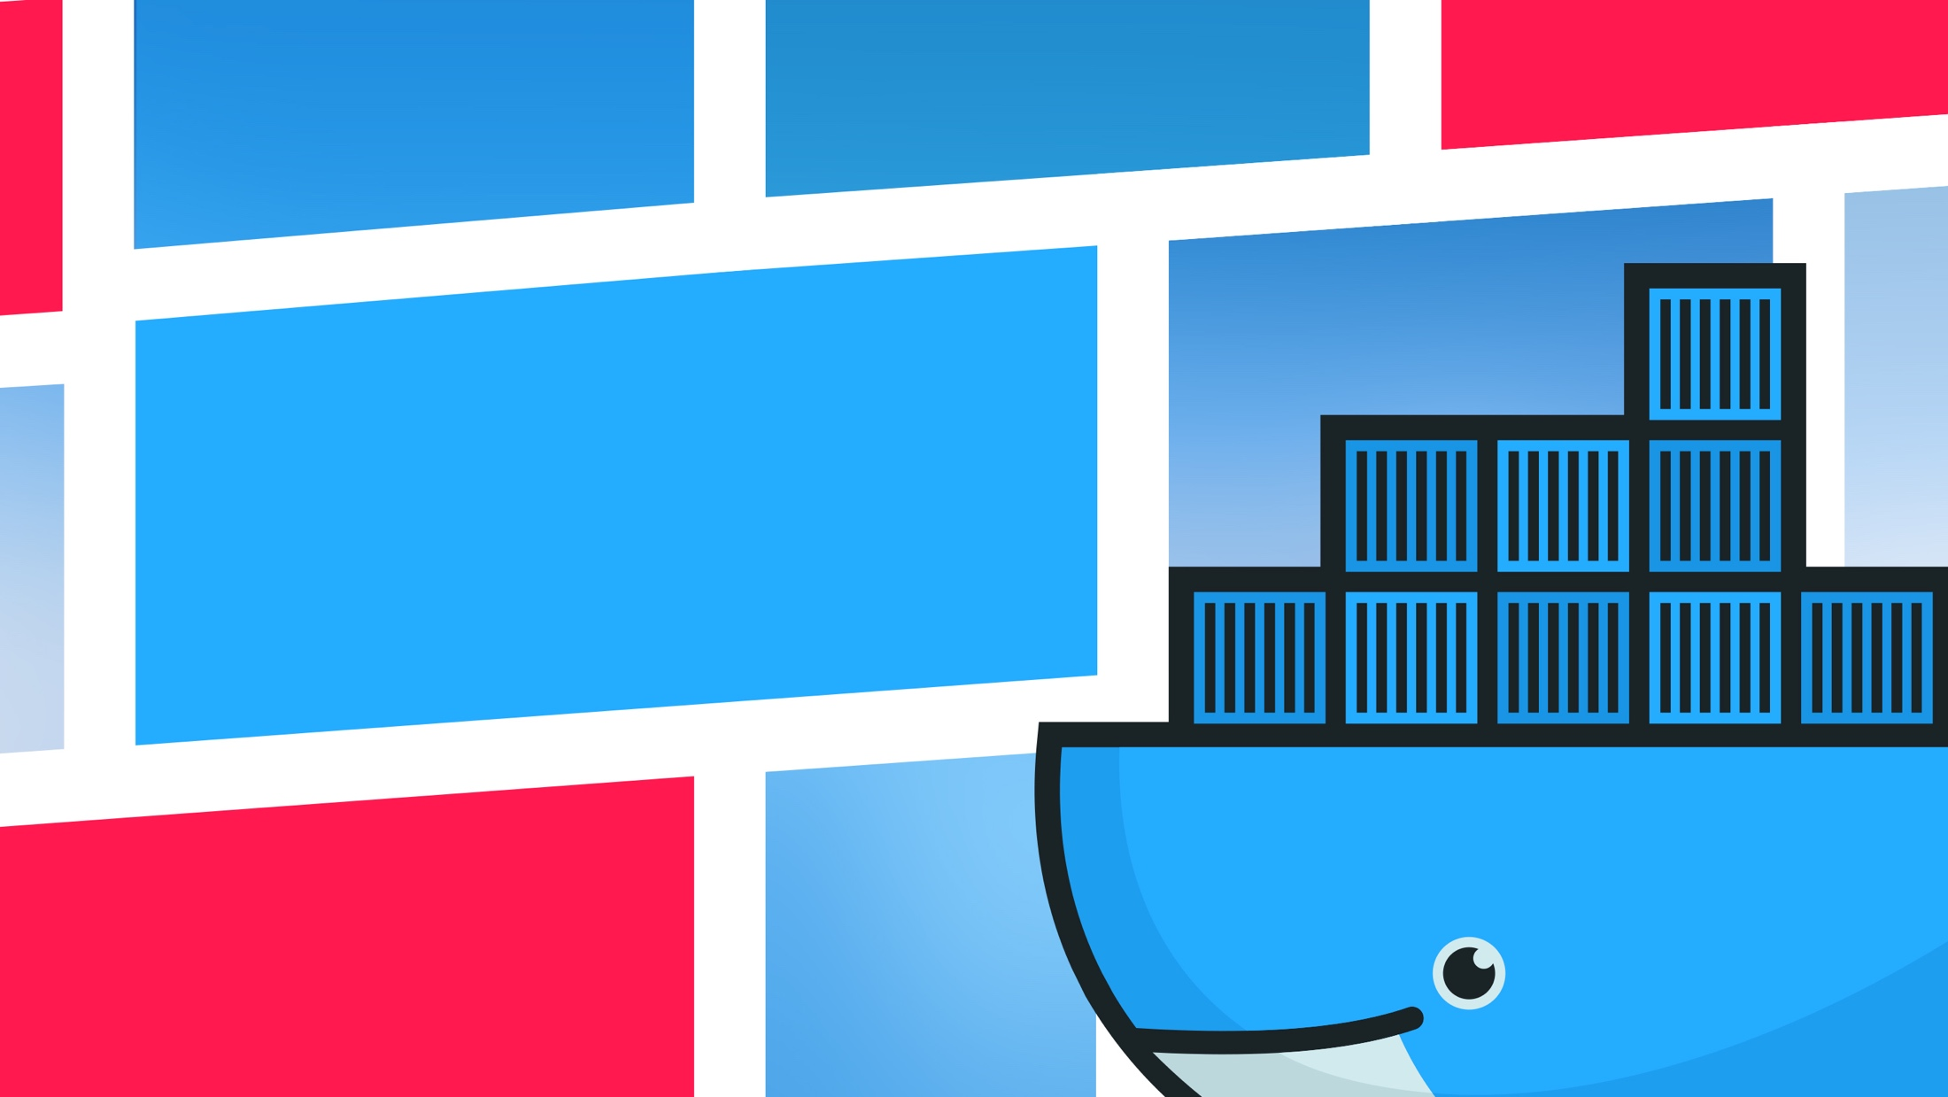
Thank you!
Follow us on Twitter:
@theVSaraswat
@ehazlett

