Slide 1
(NOTE: PASTE IN PORTRAIT AND SEND BEHIND FOREGROUND GRAPHIC FOR CROP)
Container Networking: The Good, The Bad and The Ugly
Mathew Lodge
Weaveworks

Slide 3
Container networking in last year
Good: IP per container networks, auto-updating DNS, self-wiring networks
Bad: Understanding what’s actually going on
Ugly: Robustness, multicast

Slide 4
Typical microservice scenario
API Client
API Client
API proxy / load balancer
Worker
Worker
Worker

Slide 5
The ugly: networking 1 year ago
Docker host 1
Docker host 2
Client
Worker
8080
80
8443
443

Slide 6
The good: Networking today
Docker host 1
Docker host 2
Client
Worker
80
443
Ethernet bridge on Docker host
VXLAN tunnel between hosts
Ethernet bridge on Docker host

Slide 7
The good: DNS service discovery
Container network
DNS auto-updated with container names
App view
www
www
DNS entries
10.0.0.1 www
10.0.0.2 www
10.1.0.1 svc x
10.1.0.2 svc x
10.1.0.3 svc x
10.2.0.1 svc y
10.2.0.2 svc y
www
www
LB
x
x
x
Service X
Service X
Service X
y
y
LB
Service Y
Service Y

Slide 8
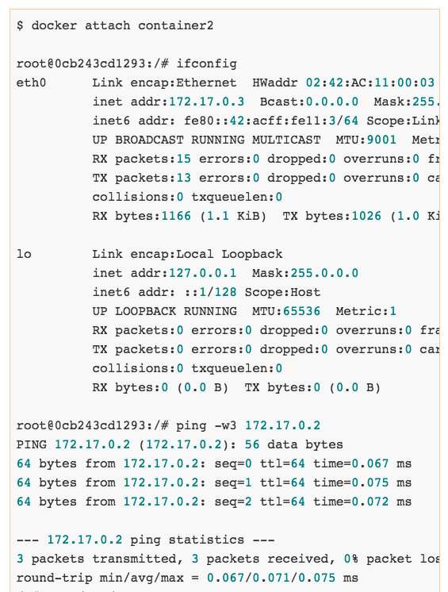
The bad: visibility

Slide 9
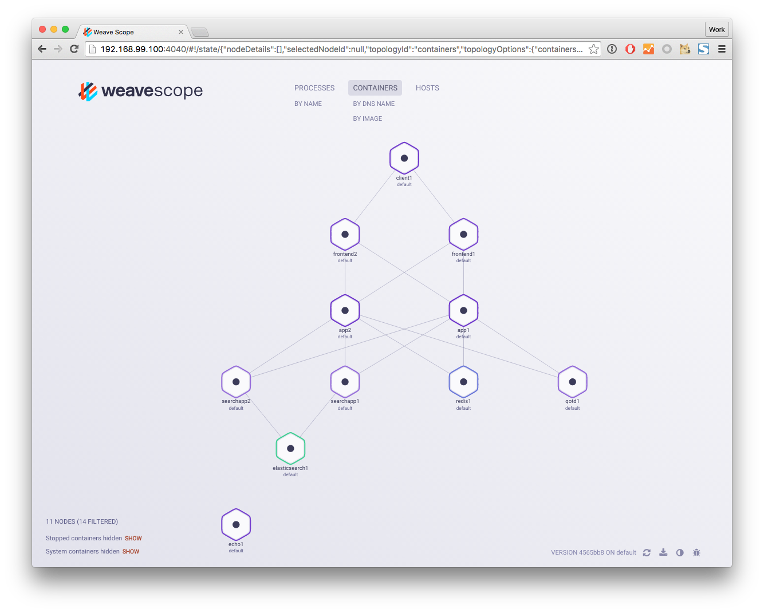
Good: Docker app visualization…

Slide 10
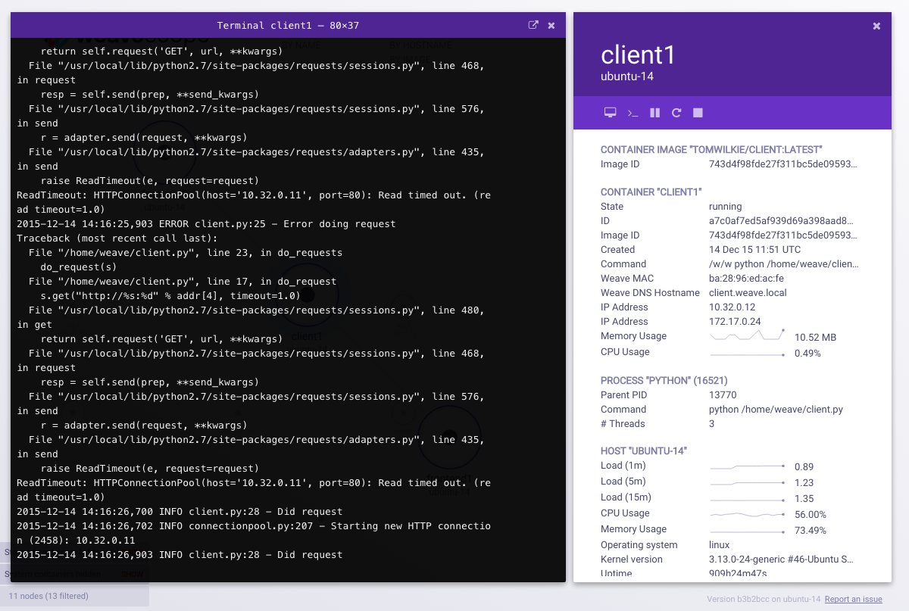
Good: …while retaining CLI access

Slide 11
Ugly: Single point of failure
Host
Host
Host
Host
Host
Consul 1
Consul 2
Consul 3

Slide 12
Good: No single point of failure
Host
Host
Host
Host
Host
Weave Net: router container per host with eventually consistent shared cache

Slide 13
Thank you!

