Slide 1

(NOTE: PASTE IN PORTRAIT AND SEND BEHIND FOREGROUND GRAPHIC FOR CROP)
Structured Container Delivery
Oscar Renalias
Accenture Container Lead

Slide 2





@oscarrenalias
github.com/accenture
oscar.renalias@accenture.com
www.linkedin.com/oscarrenalias
www.slideshare.net/oscarrenalias

Slide 3
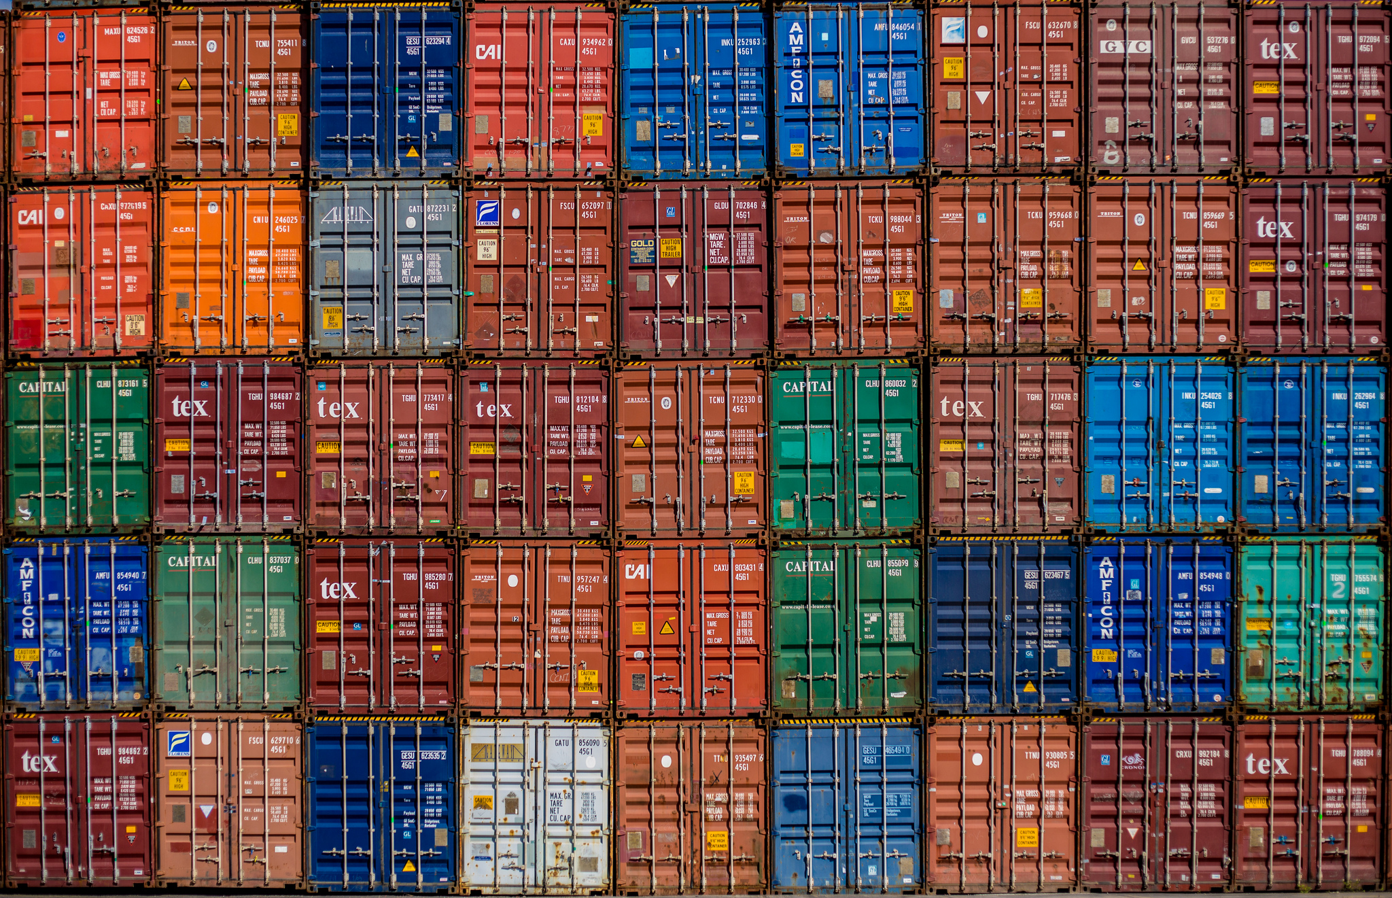
Notes:
Containers everywhere. Clients are very interested and are can definitely see the business case.

Slide 4
Benefit Type
Virtualization/ Cloud savings
Reduce/eliminate virtualization licenses for workloads to be containerized
$$$
Infrastructure Efficiency
Hardware savings
Reduce number of hardware blades/servers/cloud instances
$$$
Faster container startup times means instances can be turned off when not used, or dynamically scaled according to demand
Flexible platforms
$
Predictability
Minimize environment and configuration defects in new environment setup by packaging all components and dependencies in containers
$$
Container Benefits
DevOps
Flexible application environments
Provision an arbitrary number of application environments easily, when needed, and destroy them when done
⭐ ⭐
Efficiency
Minimize human effort / involvement with deploying code to new environments
$$$
Developer Productivity
Greatly reduce the amount of time needed for a developer to create a working application environment locally
⭐
Architecture
Alignment with modern architectures
Containers are a great runtime platforms for modern scalable and high performance application architectures, e.g. microservices
⭐ ⭐ ⭐
Notes:
Containers have clear benefits, but how do we get there?

Slide 5
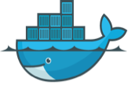
So you want to run containers?
Old stuff
New stuff
Container Platform
Notes:
So you want to run containers, but where do you start?
We need a container platform. What should be in there? What capabilities do we need? What components should provide those capabilities?
Once we have a platform, we can build stateless microservices, yay. But there’s a whole lot of legacy applications that could greatly benefit from running on containers, not least because of infrastructure cost and licensing savings.

Slide 6
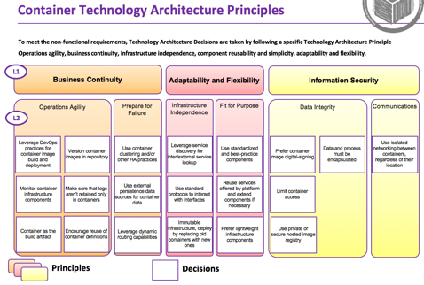
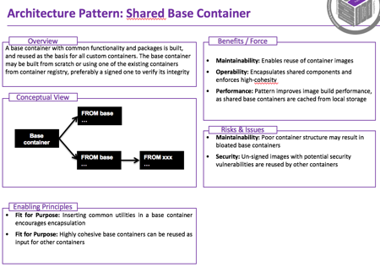
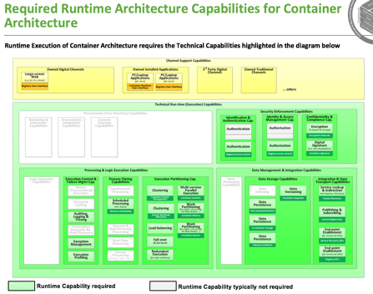
Container Reference Architecture
Principles
Patterns
Capabilities
Reference Implementations

Slide 7
Understanding how to design for, and with containers
Business Continuity
L1
Adaptability and Flexibility
Information Security
Operations Agility
Prepare for Failure
Infrastructure Independence
Fit for Purpose
Data Integrity
Communications
L2
Leverage DevOps practices for container image build and deployment
Version container images in repository
Use container clustering and/or other HA practices
Leverage service discovery for inter/external service lookup
Use standardized and best-practice components
Prefer container image digital-signing
Data and process must be encapsulated
Use isolated networking between containers, regardless of their location
Monitor container infrastructure components
Make sure that logs aren't retained only in containers
Use external persistence data sources for container data
Use standard protocols to interact with interfaces
Reuse services offered by platform and extend components if necessary
Limit container access
Container as the build artifact
Encourage reuse of container definitions
Leverage dynamic routing capabilities
Immutable infrastructure, deploy by replacing old containers with new ones
Prefer lightweight infrastructure components
Use private or secure hosted image registry
Principles
Decisions

Slide 8
How do we do <…> with containers?

Slide 9
What should the platform do?
Administration
Browser
Application Integrations
Containers
DevOps
Platform
Data
Orchestration
Resource Management
Service Discovery
Image Build/ Deployment
Metrics
Networking
Data Access
Registry
Monitoring
Runtime
Storage
Logging
Container Engine
Container Tooling
Host OS
Container OS
Infrastructure
Public/Private Cloud
VM
Bare Metal

Slide 10
Example: Component Reference Architecture for Docker Datacenter on AWS
Administration
Browser
Containers
DevOps
Image build/ Deployment
Services
Data
Docker Trusted Registry
Orchestration
Resource Management
Service Discovery
Service Discovery
Docker Compose
Universal Control Plane
Overlay DNS (intra-cluster)
Interlock
Registry
Image build/ Deployment
Metrics
Networking
Data Access
Docker Trusted Registry
Jenkins CI
CloudWatch
Overlay Network
Flocker
Storage
Runtime
Docker Volumes
Monitoring
CloudWatch
Engine
Container Tooling
Storage
Docker
Docker
EBS
Logging
CloudWatch Logs
Host OS
Container OS
Amazon Linux
Infrastructure
EC2

Slide 11
How about the old stuff?
Old stuff
New stuff
Container Platform
Notes:
So you want to run containers, but where do you start?
We need a container platform. What should be in there? What capabilities do we need? What components should provide those capabilities?
Once we have a platform, we can build stateless microservices, yay. But there’s a whole lot of legacy applications that could greatly benefit from running on containers, not least because of infrastructure cost and licensing savings.

Slide 12
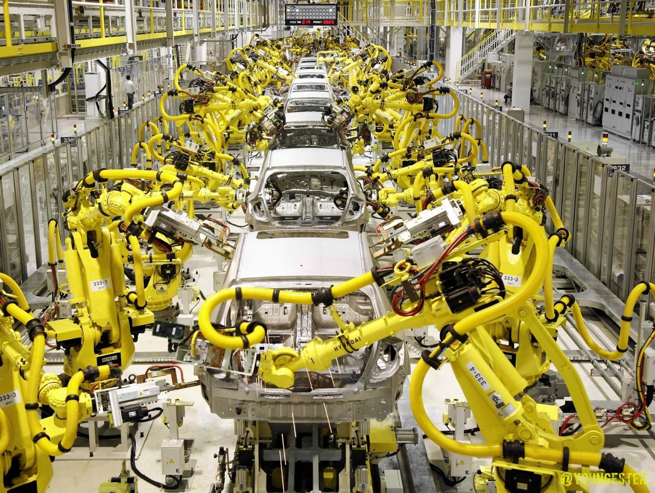
Efficiently migrating applications to containers

Slide 13
Central Internal Team
Project-based migration
Migration factory
Migration conducted by an internal team, staffed by current IT resources
Leverage existing project team group to orchestrate and execute migration effort
Centralized team working in concert with project teams to coordinate and migrate projects to the new platform
Team has other priorities
Limited or non-existent container skills
Limited migration skills
Increased number of resources
Limited cross-team knowledge sharing
Lengthier migration
Inconsistent migrations
Fast, efficient deployment
Shared team provides economies of scale and knowledge sharing
Optimized resource model
Focused on migration delivery and managed to avoid cost overruns

Slide 14
Migration Factory
Legacy Application
Migration Team
Legacy Application
Legacy Application
Migration Framework
Legacy Application
Container Patterns
Container Best Practices
Base Images
Legacy Application
Container Reference Architecture
Docker
Repeatable, industrialized
Low risk
Cost-efficient

Slide 15
Establish Overall Migration Plan
Perform Detailed Migration Planning
Upgrade/Migrate
Applications
Certify/Deploy
Applications
Discovery & Assessment
Migration & Rollout
High-Level Assessment & Planning
Detailed Application
Assessment
App. Architecture
Recommendations
Containerize Application
Testing & Certification
Rollout & Decom-mission
Container Infrastructure Planning

Slide 16
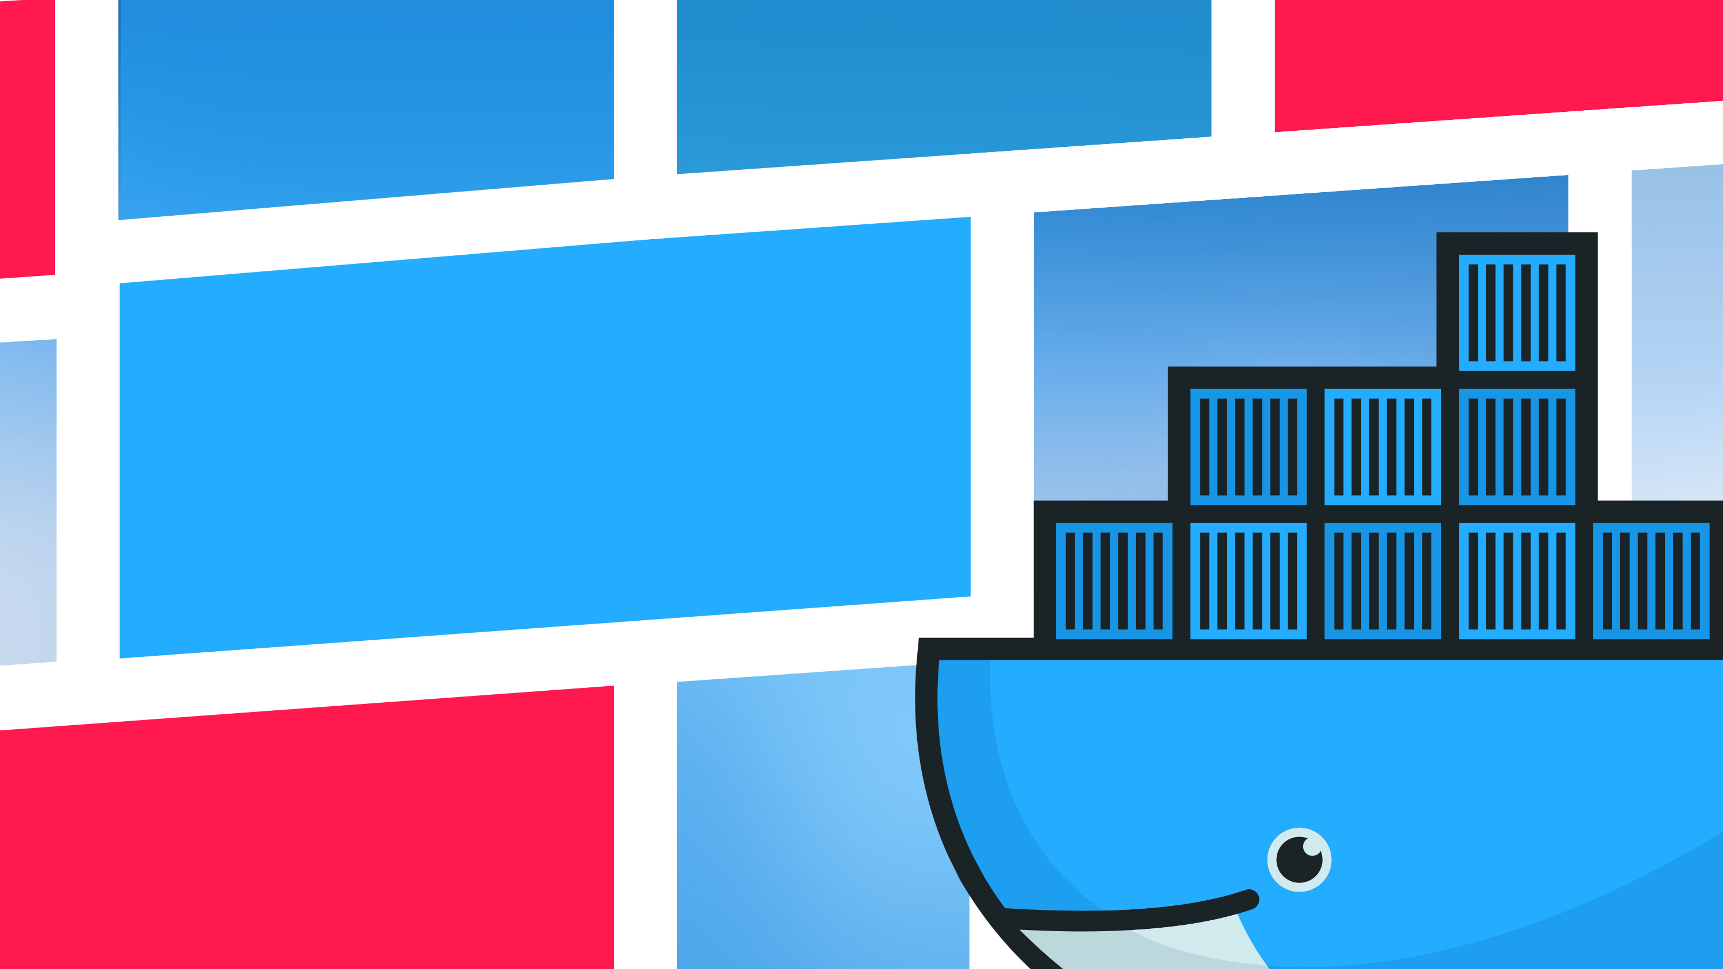
Thank you!

