Slide 1



Take an Analytics-Driven Approach to Container Performance
Marc Chéné, Principal Product Manager
Den Gladkikh (aka outcoldman), Principal Dev Engineer
Notes:
Monday June 20, 2016 – 5:20 to 6:05pm, http://dockercon2016.sched.org/event/70WH - Take an Analytics-driven Approach to Container Performance with Splunk for Container Monitoring by Splunk
Time constraints: 20mins - Time breakdown
Slides 1-13 --> 6mins
1st Demo - slide 14 --> 10 mins
Cloud 15-16 --> 2 mins – UCP in AWS with 4 nodes across 4 AWS Zones… show a map of logs by AWS regions / public IPs
Call to action --> 2mins

Slide 2

Agenda
Splunk What?
Splunk Analytics
Containers in the Cloud
Notes:
Splunk What?
- Who we are?
- How can we Help?
Splunk Analytics
- Getting Data In
- Splunk Images
- It’s time for Analytics

Slide 3

Splunk What?
Let's talk about Splunk

Slide 4
First, a bit about containers…

Slide 6


But...Containers Add Complexity

Slide 7


Make machine data accessible,
usable and valuable to everyone.
7

Slide 8
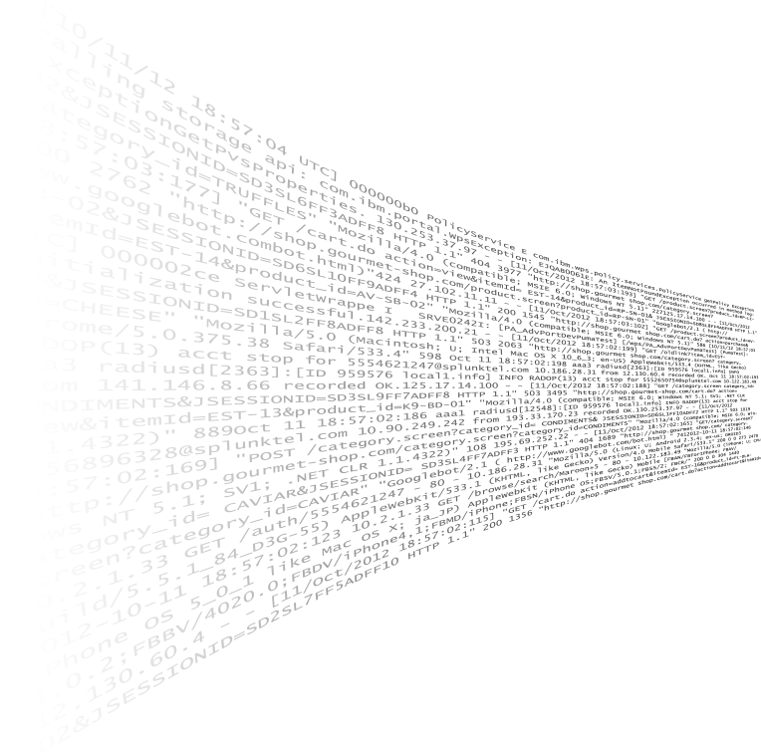


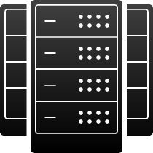

























Turning Machine Data Into Business Value
Index Untapped Data: Any Source, Type, Volume
Ask Any Question
Application Delivery
Containers
Online Services
IT Operations
Web Services
On-
Premises
Servers
Security
GPS Location
Security, Compliance and Fraud
Packaged Applications
Networks
Storage
Desktops
Private
Cloud
Custom
Applications
Business Analytics
Messaging
Telecoms
RFID
Online Shopping Cart
Energy Meters
Internet of Things and Industrial Data
Databases
Public
Cloud
Web Clickstreams
Call Detail Records
Smartphones and Devices

Slide 9









































































































Proven at 11,000+ Customers in 100 Countries
More Than 80 of the Fortune 100
Cloud and Online Services
Education
Energy and Utilities
Financial Services and Insurance
Government
Healthcare
Manufacturing
Media
Retail
Technology
Telecommunications
Travel and Leisure

Slide 10
Splunk Analytics
Getting Data In
Splunk Images
It’s Time for Analytics

Slide 11
Splunk Monitoring Options for Docker
Docker Native Logging – Splunk logging driver, Syslog, JournalD
Universal Forwarder – App Logs, Syslog forwarding, Performance, etc.
Logging libraries in .NET, Java and node.js
Custom (e.g., Kafka with HTTP Event Collector)
Cloud – AWS, GCP, Azure
Use the option that is right for you!

Slide 12
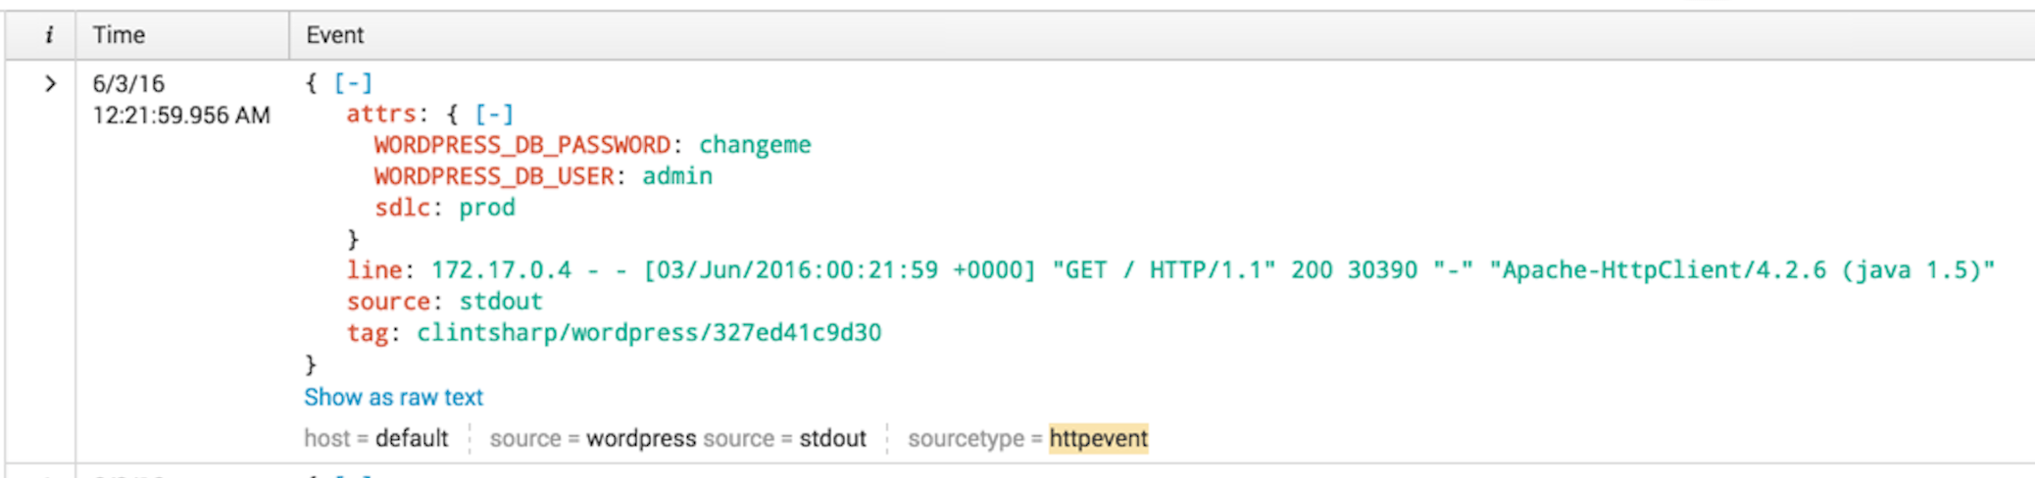
Benefits of Native Splunk Logging Driver
Secure—supports TLS/SSL
RBAC
Simple to setup
Event Collector
Easy data collection top of Splunk HTTP
Scalable—built on top of Splunk HTTP Event Collector
Notes:
Natively built in docker codebase
HEC, http://dev.splunk.com/view/event-collector/SP-CAAAE6M

Slide 13
Docker Store Images
splunk/enterprise
  6.4.1 & latest
  6.4.1-monitoring
splunk/universalforwarder
  6.4.1 & latest
  6.4.1-monitoring
Notes:
to confirm: when are they announcing the Docker Store
Benefits of the Docker Store

Slide 14
Demo Time!
Getting Data In
Splunk Logging Driver
Analytics

Slide 15
Containers in the Cloud

Slide 16
Support for Docker in the Cloud
Amazon Web Services (AWS)
  Cloud Watch ECS Metrics
  AWS Logs
Google Cloud Platform (GCP)
  StackDriver Pub/Sub
  StackDriver Cloud Monitoring

Slide 17
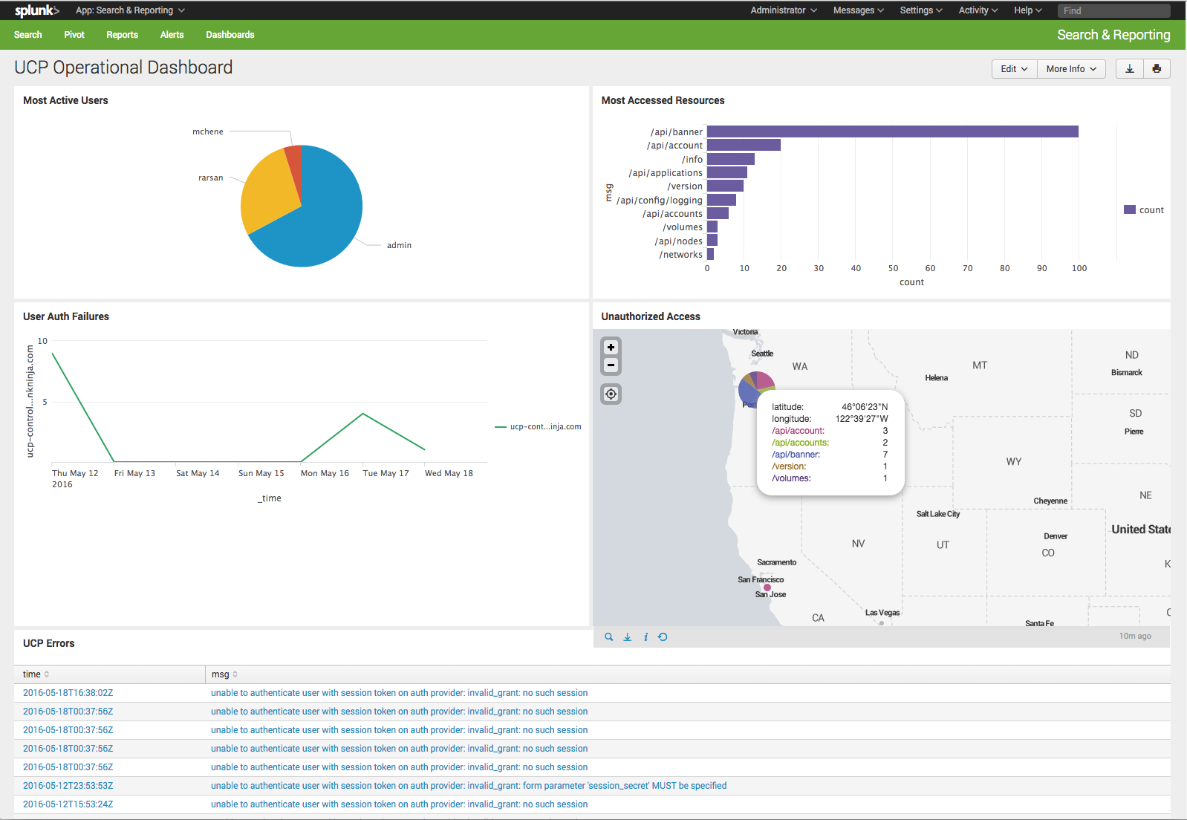
Visibility to your Container Environments
Splunk Add-On for Docker Universal Control Plane
Monitor Changes – Identify changes in containers, updates to container deployments
Usage Insight – Insight into containers, clusters, and nodes
Analyze and Correlate – Changes, usage, errors and configuration
Improve Docker container compliance, availability and performance

Slide 18

Call to Action…
# 1. Come visit us at our booth
docker run splunk/visitourbooth
visitourbooth_1 | Booth #G2
# 2. Start using the Splunk logging driver
docker run --name wordpress --label web=wordpress \
--log-driver=splunk \
--log-opt splunk-token=00000000-0000-0000-0000-000000000000 \
--log-opt splunk-url=https://192.168.99.100:8088 \
--log-opt labels=web --log-opt tag="{{.Name}}" \
--publish 80:80 \
-d wordpress

Slide 19

Thank you!

