Slide 1
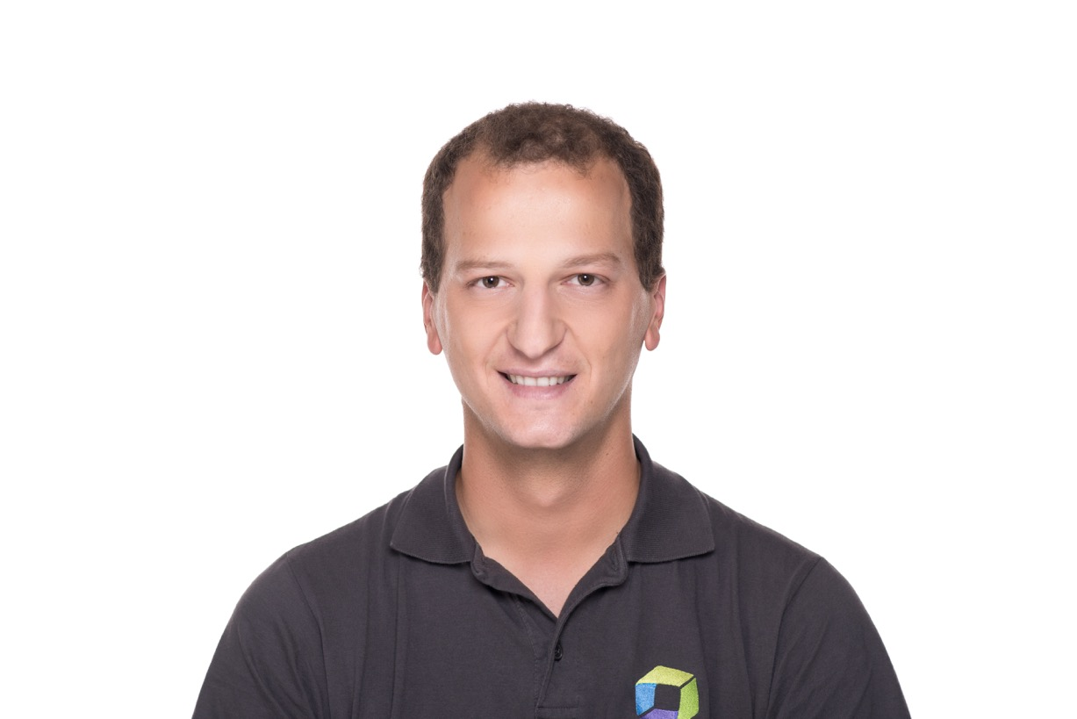
Mushroom Cloud Effect
Alois Mayr
Technology Lead – Dynatrace

Slide 2
Monitoring for Highly Dynamic Container Environments
Notes:
Who am I and what we do
Dynatrace the monitoring company with a solution for highly dynamic cloud and container environments
Many customers, lots of experience, production monitoring,

Slide 3
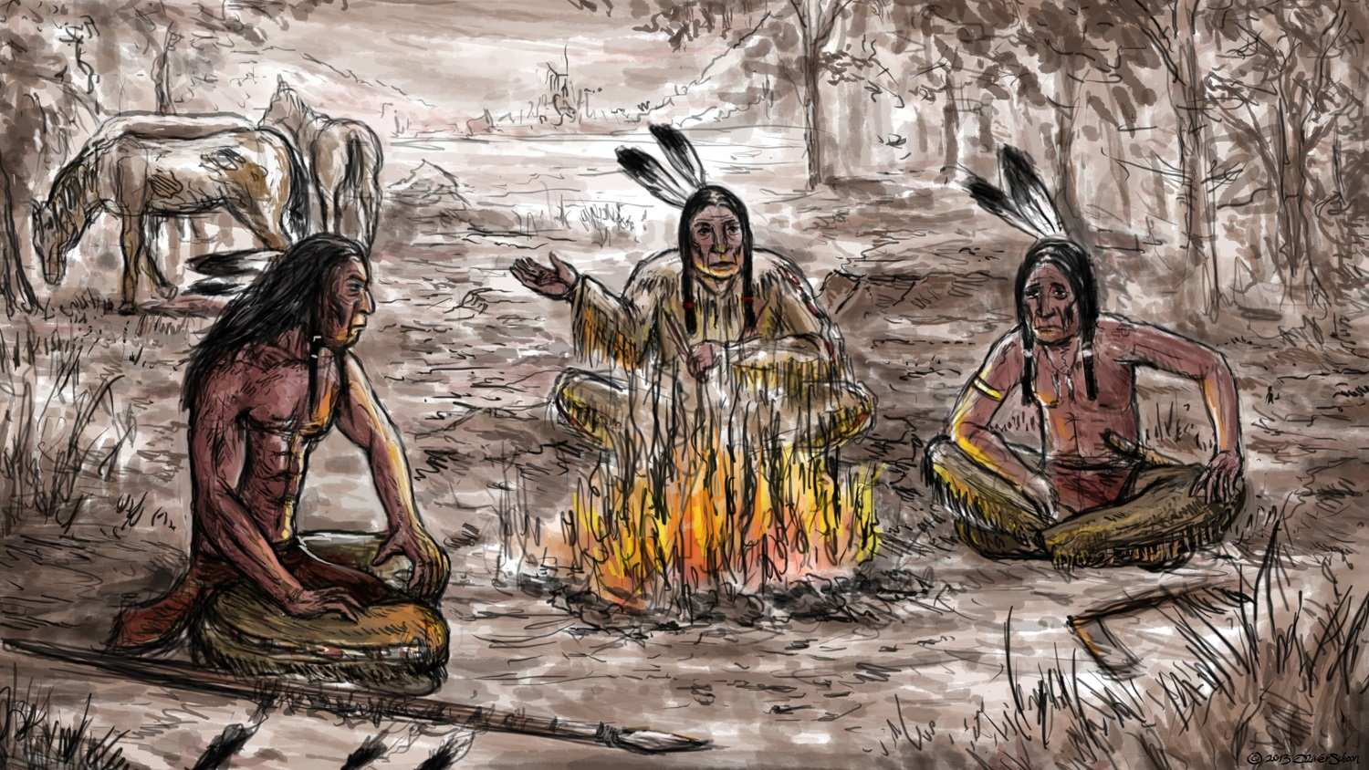
…there’s been the mushroom cloud effect
oh yeah, everything screwed up
Source: http://www.schoonoart.de/
Notes:
There are many campfire stories we could go into … but today I’m gonna talk about the Mushroom Cloud Effect
Go into context here. Mushroom cloud effect we see very often in dynamic container environements with lots of microservices etc.

Slide 4
The Mushroom Cloud Effect
or
What Happens When Containers Fail?

Slide 5
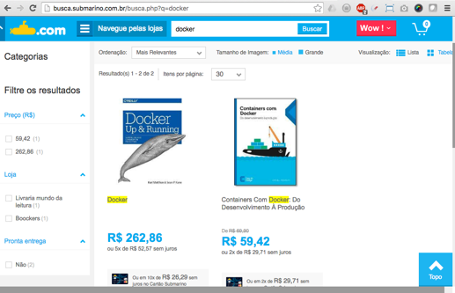
Biggest LatAm e-commerce Company
~ U$ 2.5 billion revenue
4 sites: Americanas, Shoptime, Submarino, Soubarato
~ 150 hosts across 4 regions
5k-15k containers
1k-3k services

Slide 6
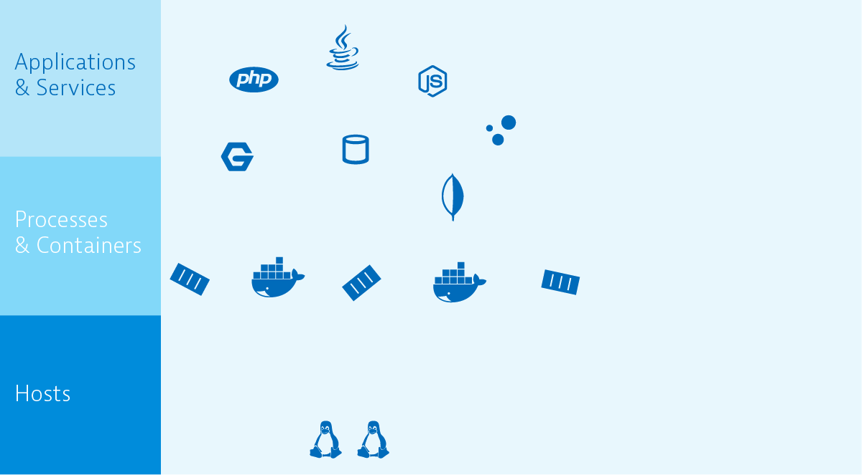
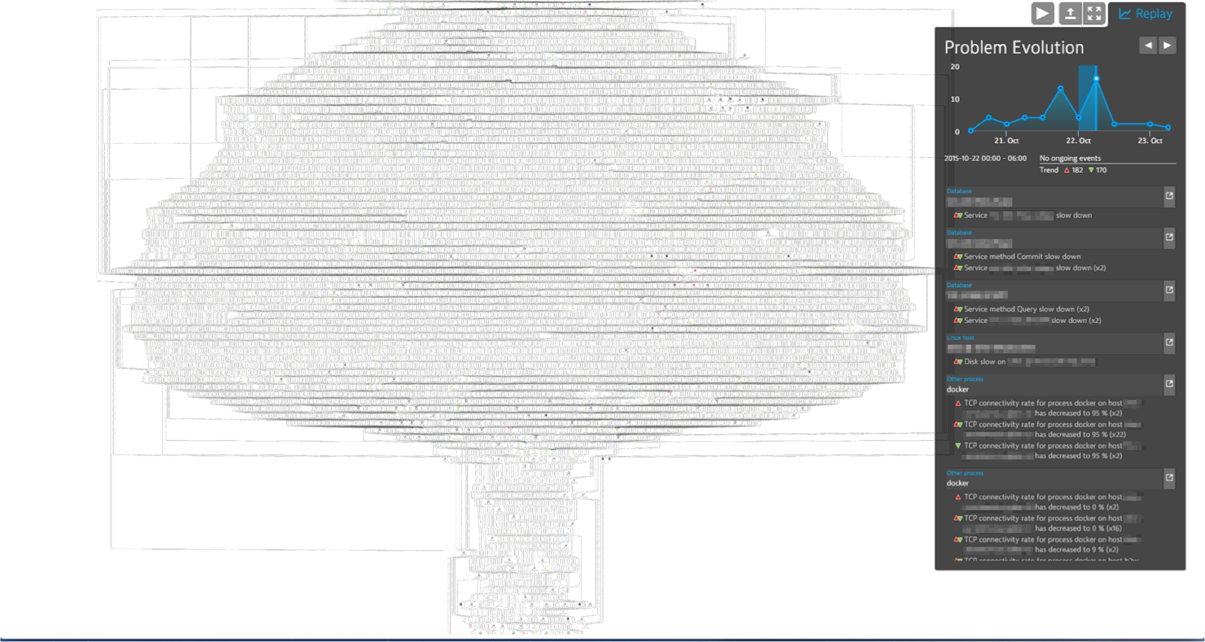
TL;DR

Slide 7
About Cloud-Scale Systems

Slide 8
Important Aspects…
Lots of (micro-)services
Lots of communication between services
Service dependencies
Versioning and API compatibilities
Zero downtime
Notes:
All the services should work as designed
You need to be careful of api and service compatibilities
Additional complexity through feature sets cross geo-location availability
Usually designed for zero downtime
Most of them apply to netflix website services

Slide 9
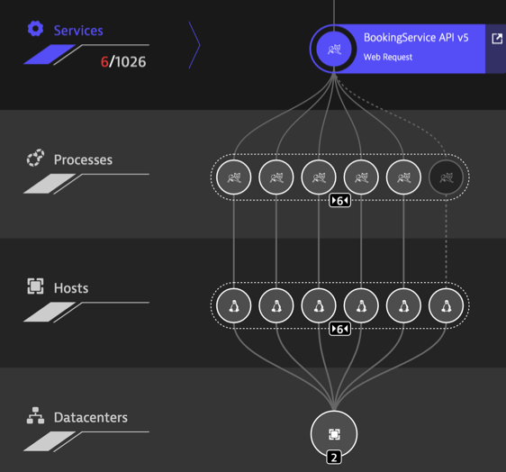
Platform-related Aspects
Most often container-based
Clustered for scalability
Ephemeral containers
Resilient architecture
Cross AZ fail-overs
SDN for communication
Notes:
However, running such services often done with paas or paas like systems
Container based
One container, one service
One service, multiple containers – somewhere across different hosts
Containers are ephemeral, regularly killed and started
Orchestration not only for scheduling but also for resilience at container level

Slide 10
Deployments are no Longer Static
12:00 p.m.
Scaled up service during peak load
with failover of problematic node
7:00 p.m.
Scaled back down to lower load, move to different geolocation
7:00 a.m.
Low load, service running
with minimum redundancy

Slide 11
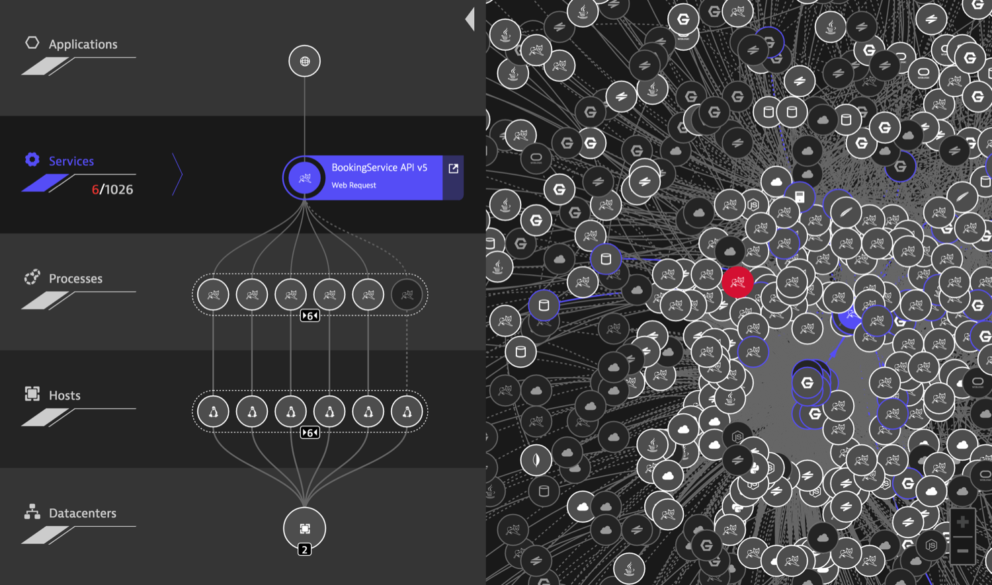
Anatomy of dynamic environments
https://www.dynatrace.com/en/ruxit/
Notes:
This is an example of one of our customers – B2W the largest e-commerce provider in LatAm
Left hand side: a single service in v5 provided by 5 containers – one is offline. The conainers run on separate hosts in 2 datacenters.
This is the technical part
Right hand side is a mess – all services communicate somehow to each other. Service dependencies and communication needs to be real-time

Slide 12
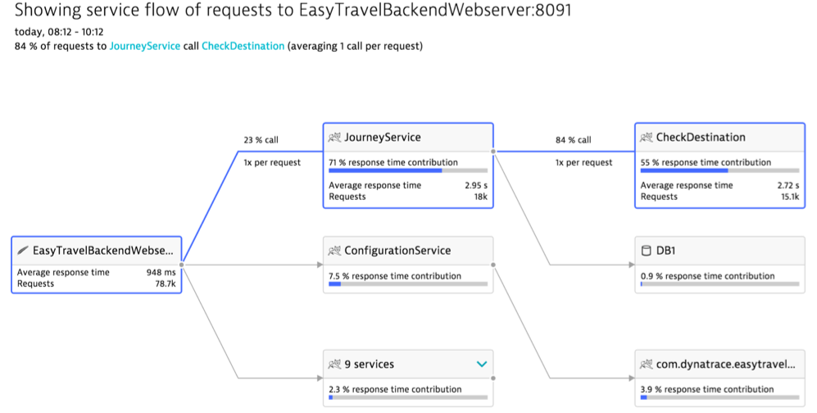
All About (Service) Dependencies
Notes:
This is a way simpler environment that shows the flow of transactional apps.

Slide 13
Failing containers…
…may or may not have an (immediate) impact to service performance

Slide 14
Cascading Failures Lead to a Mushroom Cloud Effect

Slide 15
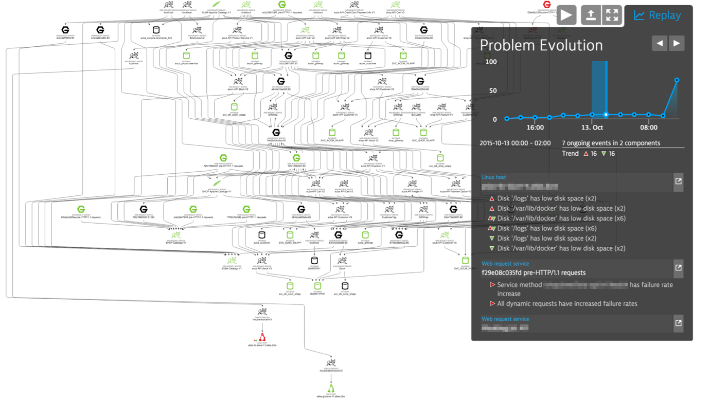
Notes:
Example of a small mushroom cloud effect
Bottom: Hosts
Middle part: processes / containers
Top: services and applications

Slide 16
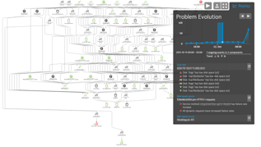
The Hungry Container Breakdown
What was the problem?
Shared /logs partition on host
No log rotation, no archiving for app logs
No proper log management used for Docker environment
Shared /logs partition ran out of space

Slide 17
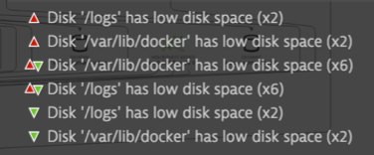
The Hungry Container Breakdown
How the problem has evolved over time?
Container health checks failed
Orchestration killed container and rescheduled new one
Still no free space on /logs
Termination and rescheduling
/var/lib/docker ran out of space
Cluster nodes were no longer able to run any containers

Slide 18
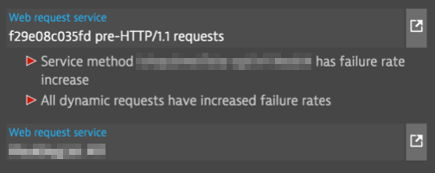
The Hungry Container Breakdown
How the problem affected services?
Services at the top of the graph
Increased failure rates
Lots of depending Tomcat and DB services affected

Slide 20
The Hungry Container Breakdown
How the problem could have been avoided?
Log management tools for app logs
--log-driver=none|syslog
Remove container
--rm=true
/var/lib/docker deserves its own partition

Slide 21
The Hungry Container Breakdown
Buggy Containers May Kill Your Nodes

Slide 22
Try to Break Your Clusters Early (And be Prepared for Black Friday)

Slide 23
Break Your Clusters Early
Massive load testing!
Include everything Services, Containers, Orchestration, EC2 instances
Survive three days of pain

Slide 24
Testing everything
13.3k containers (+nodes)
3,451 services

Slide 26
Automation Needed to Pinpoint the Root Cause of Cascading Failures!

Slide 27
Want to learn more?
Stop by our booth!
G15

Slide 28
Thank you!

