Slide 1
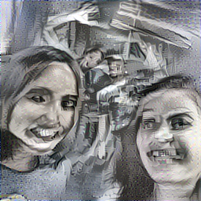
Tyrion Cannister: Neural Style GUI
@DoraKorpar
@SiphanBou
Full-Stack Software Engineering Students @holbertonschool

Slide 2
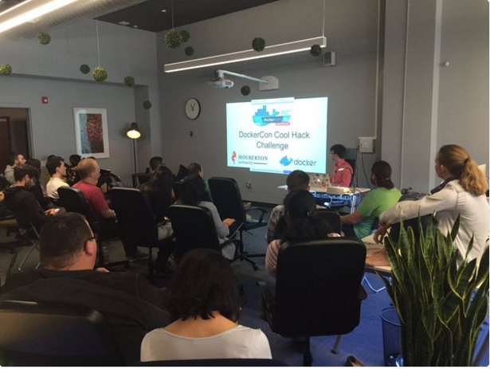
Agenda
Part 1 - How did we end up here Part 2 - What we built and why

Slide 3
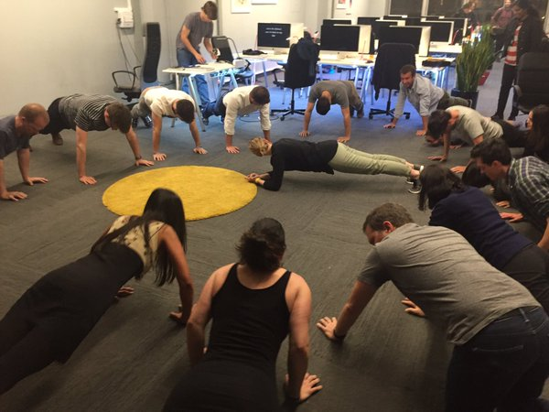
Part 1 - How did we end up here?

Slide 4
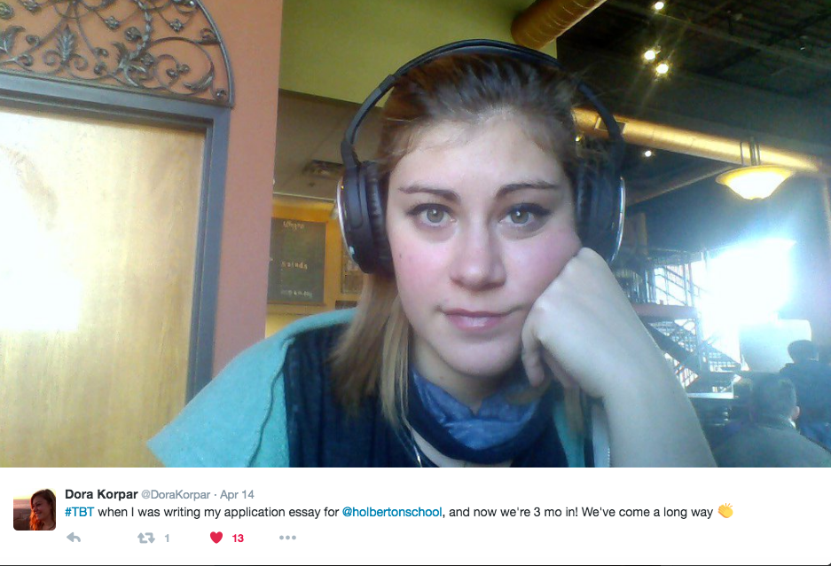
1.1 Before Holberton
Dora
Siphan

Slide 5
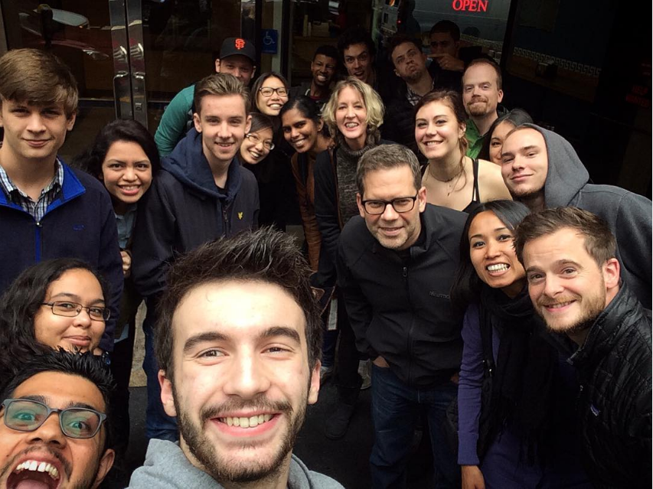
1.2 About Holberton School
In San Francisco
Open to anyone
Project-based
Peer learning
2 years incl. 6 month internship
Valuable network of 100+ mentors

Slide 6
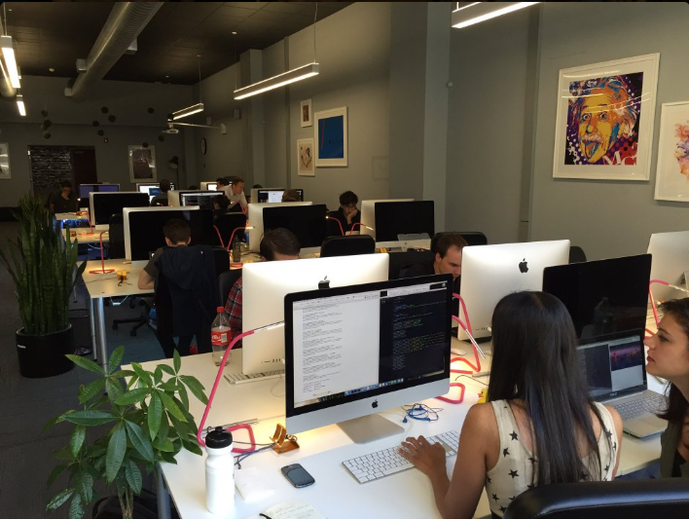
1.3 Docker Hackathon
Sponsored by Docker
Very first hackathon!
Applying what we’ve learned

Slide 7
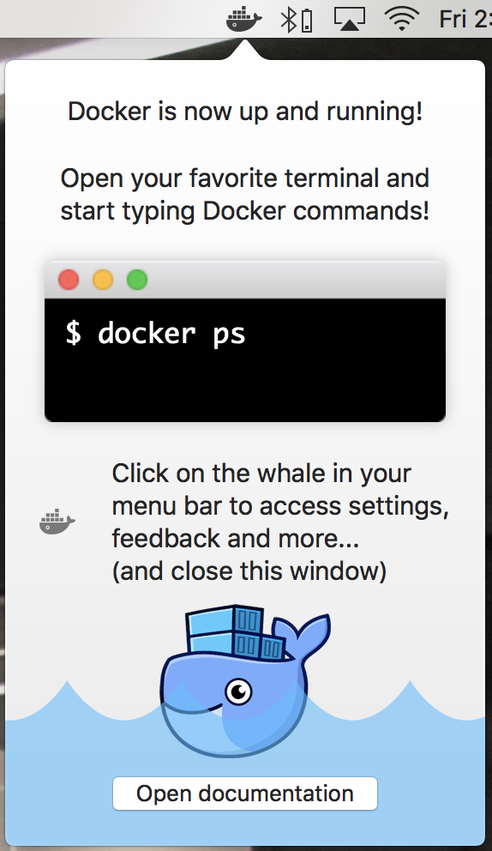
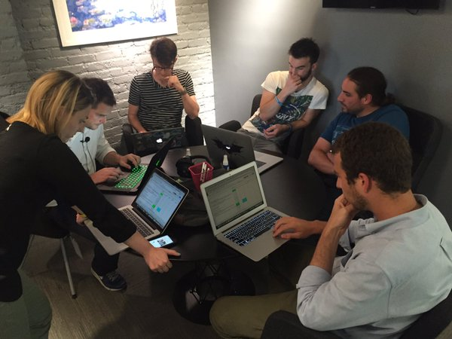
1.3 Docker Hackathon
Build, Ship and Run cool apps with Docker
Challenge: finding an idea that’s cool and useful
Experimenting with Docker Mac Beta

Slide 8
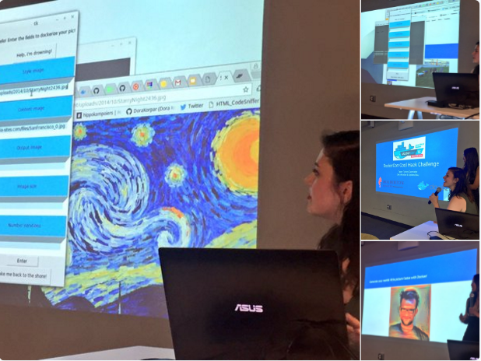
Part 2 - What we built and why

Slide 9
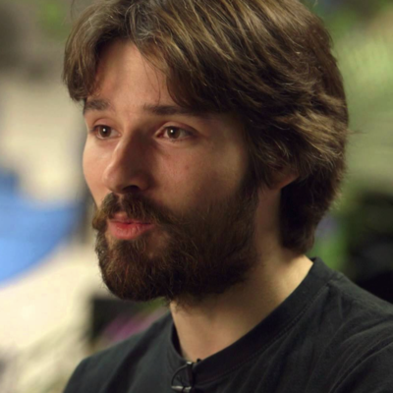
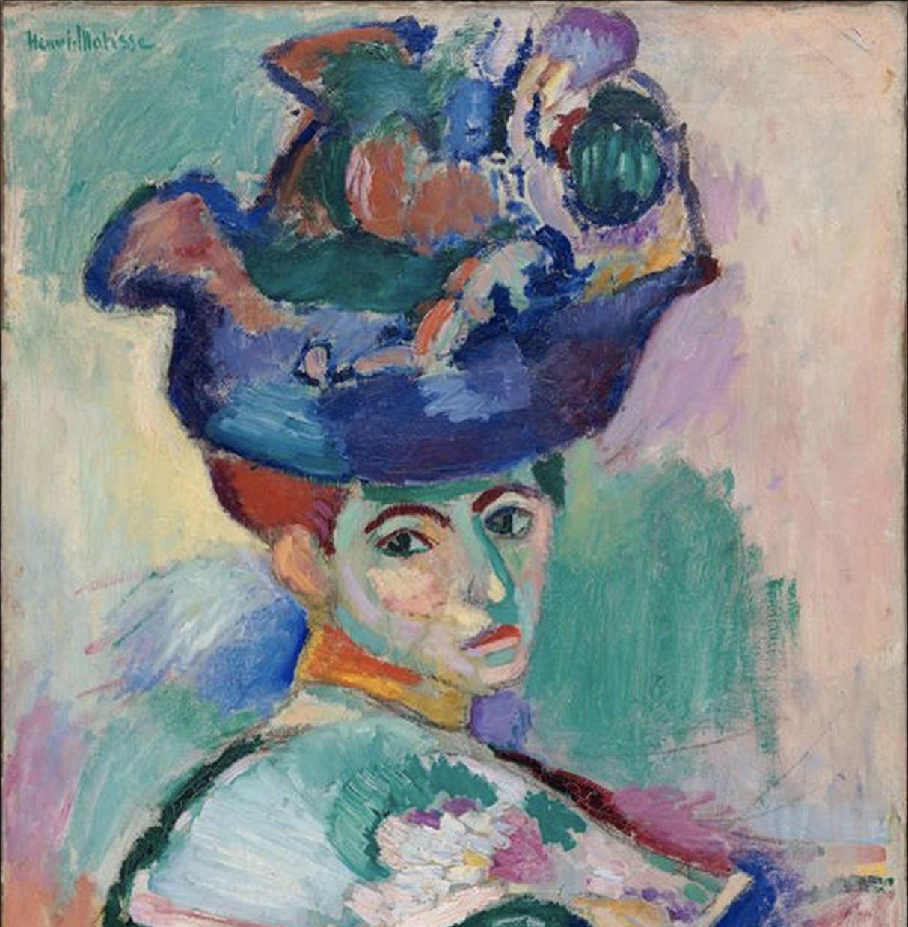
2.0 - What is neural styles?
Choose a picture & a painting style
+

Slide 10
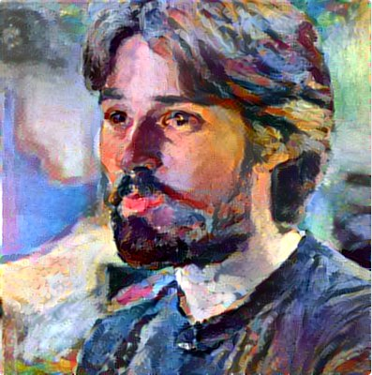
2.0 - What is neural styles?
Choose a picture & a painting style
+

Slide 11
2.1 - Neural styles made simple
Open container with
Open GUI with “nsgui”
User-friendly:
No need to understand algorithm
Demo!
docker run -it --env="DISPLAY" --volume="/tmp/.X11-unix:/tmp/.X11-unix:rw" dorakorpar/nsgui:latest

Slide 12
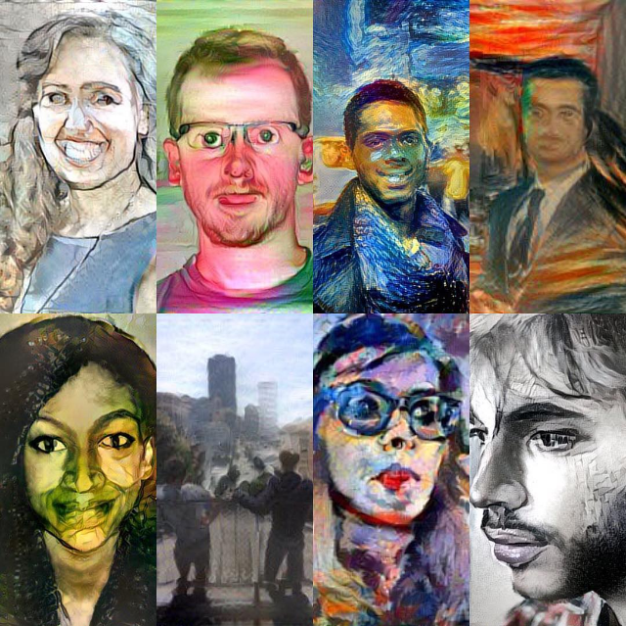
2.2 - Why neural styles?
Technology meets Art:
A visual way to introduce Deep Learning
Increasing and promoting accessibility
Not just for developers

Slide 13
2.3 - Room for improvement
Fix errors with EOG
Documentation
Use nvidia-docker to access GPU from Docker container
Expand functionality to Mac and Windows users
Contribute! It’s open source :)
https://hub.docker.com/r/dorakorpar/nsgui/
https://github.com/DoraKorpar/DockerCon-Challenge
Notes:
https://github.com/NVIDIA/nvidia-docker

Slide 14
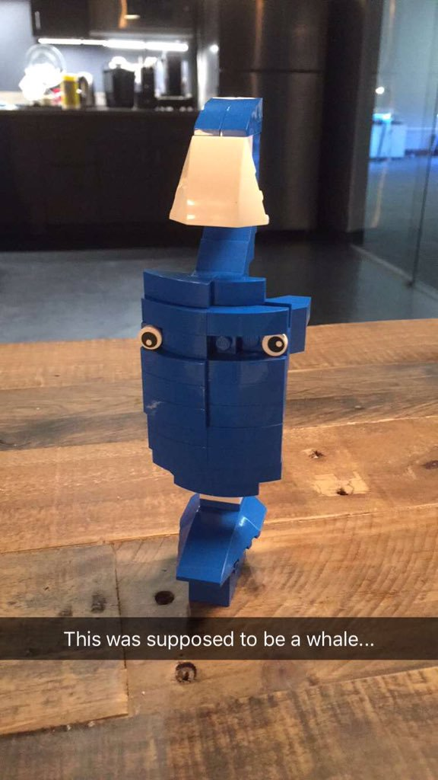
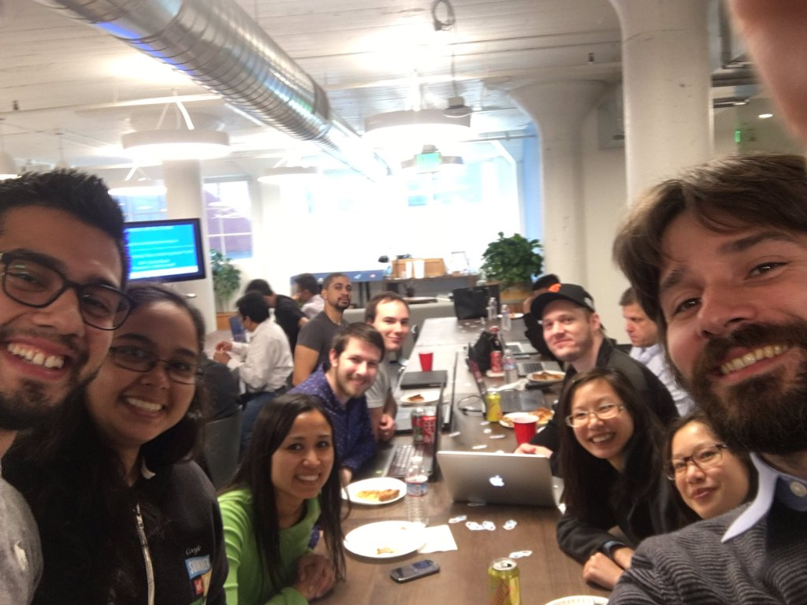
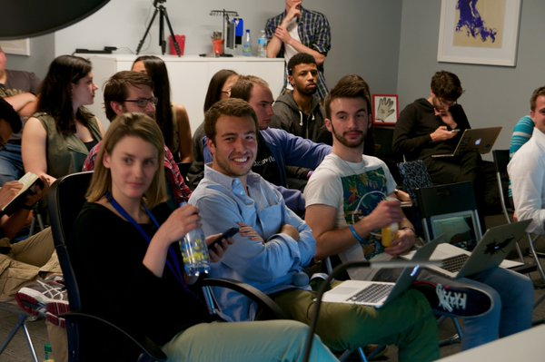
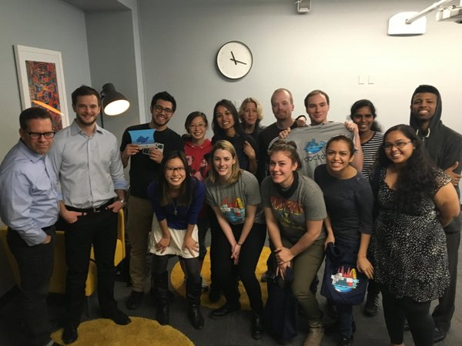
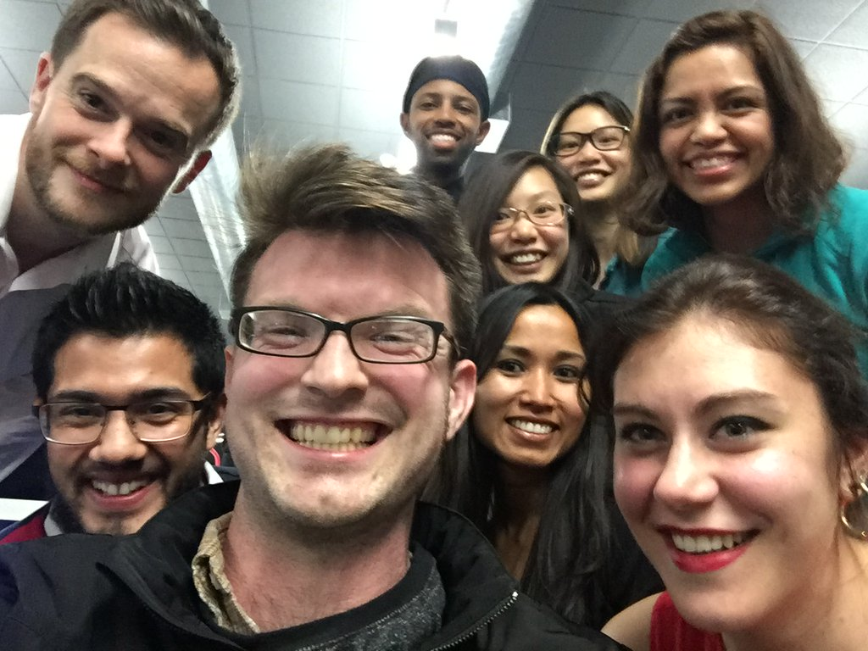
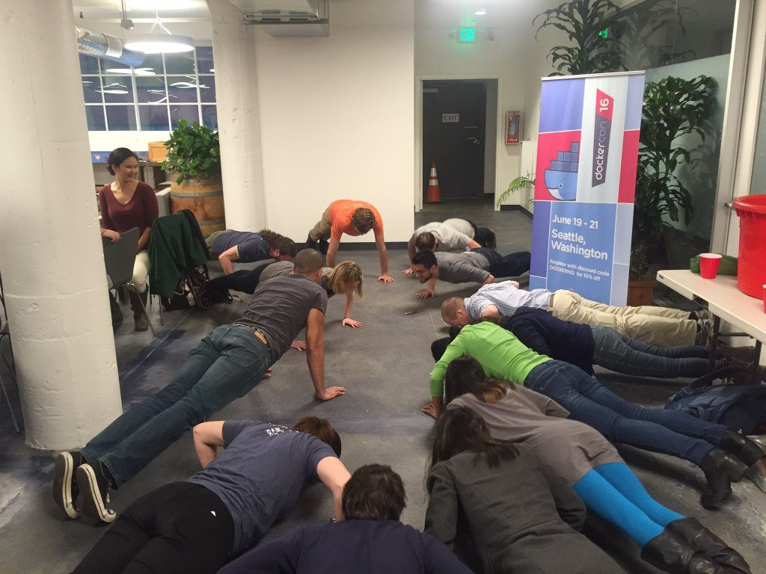
Thank you Docker!

Slide 15
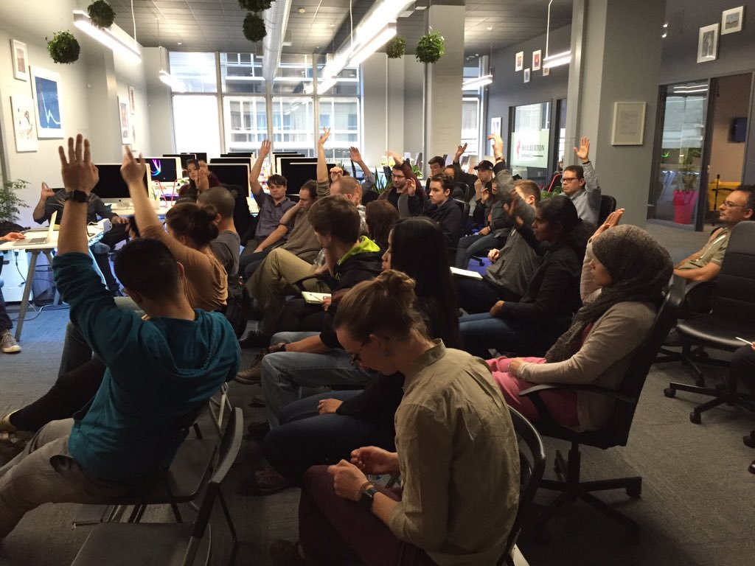
Questions?

Slide 16
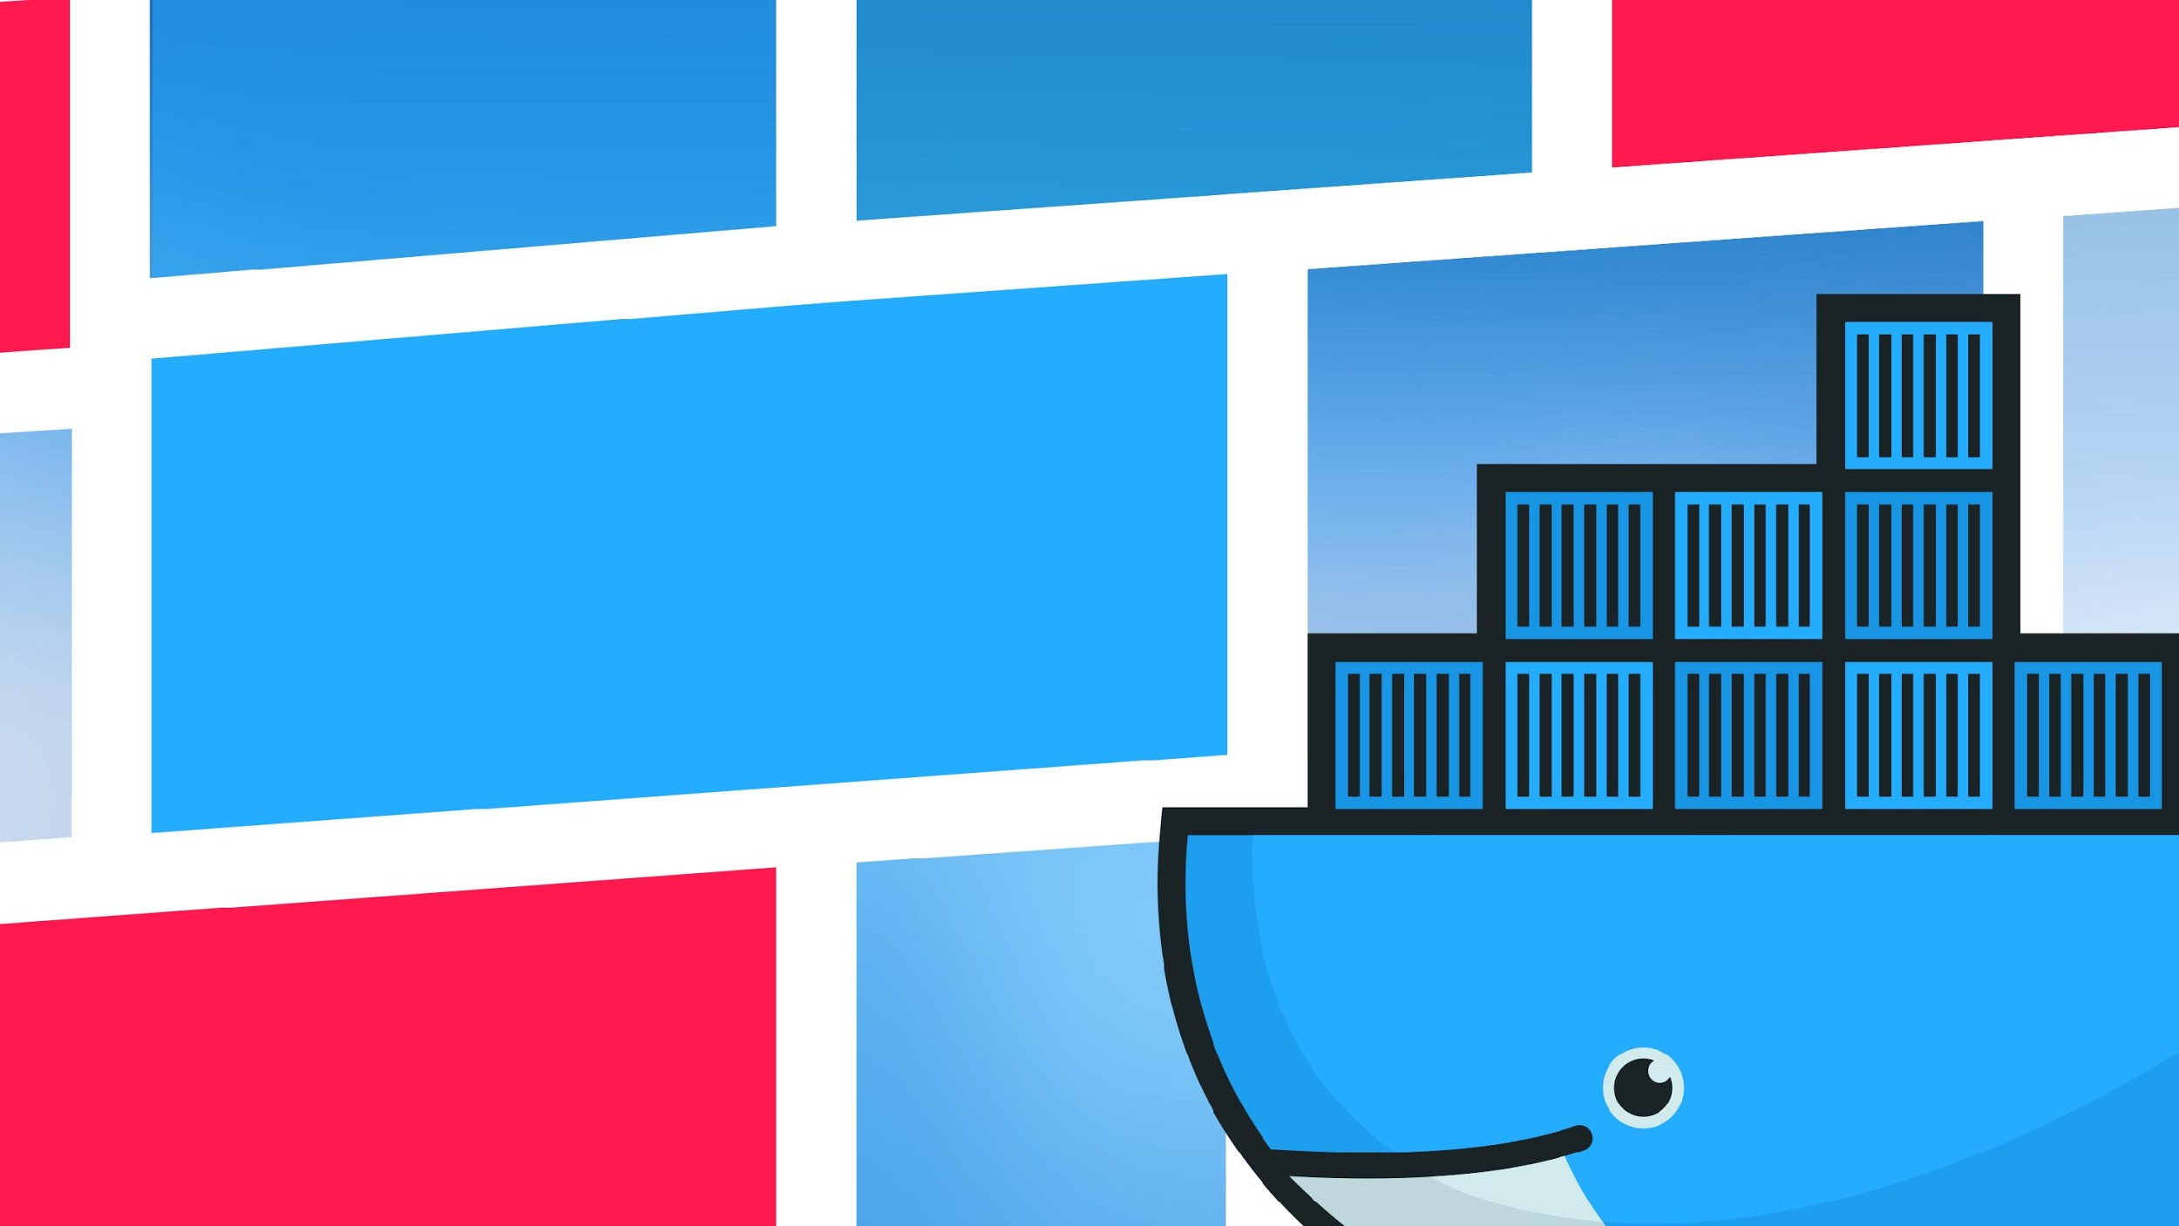
Thank you for listening!
@DoraKorpar
@SiphanBou

