Slide 1
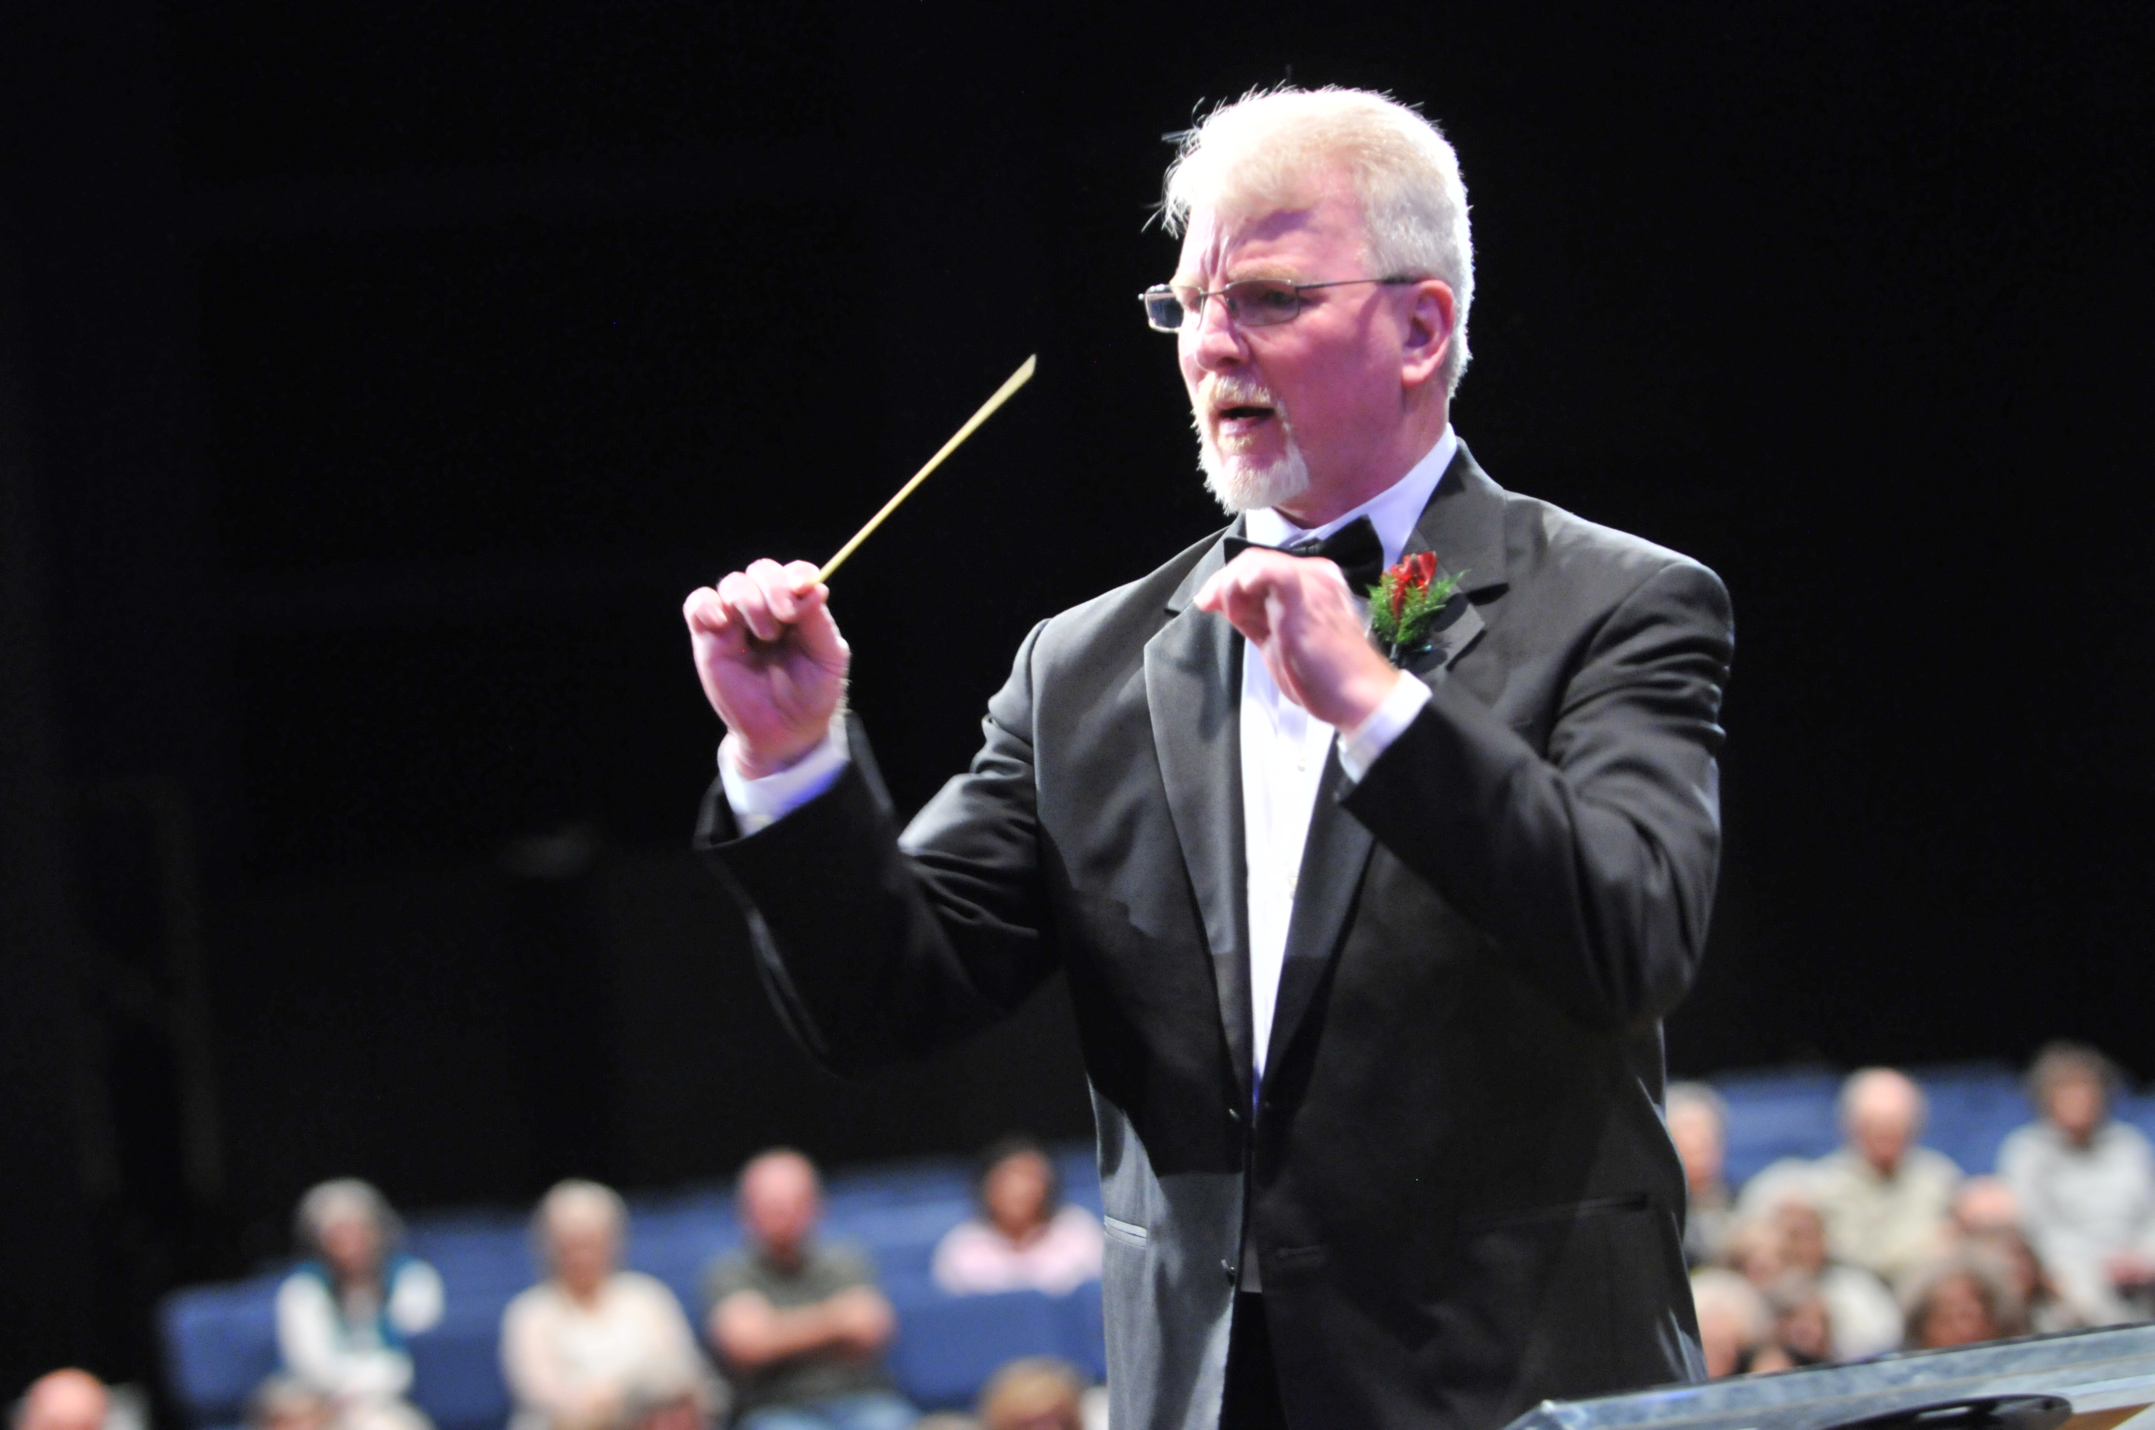
(NOTE: PASTE IN PORTRAIT AND SEND BEHIND FOREGROUND GRAPHIC FOR CROP)
Overseeing Ship’s Surveys and Surveyors Globally Using IoT and Docker
Jay Blanchard
Software Systems Engineer
Fugro Chance, Inc.
Aater Suleman
Co-Founder & CEO Flux7
Notes:
I’ll change the picture or make a comment about how DEVOPS is like conducting.

Slide 2
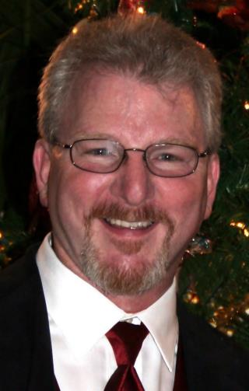
(NOTE: PASTE IN PHOTO AND SEND BEHIND FOREGROUND GRAPHIC FOR CROP)
Fugro Chance Inc. is among the world’s most trusted and innovative survey companies. A wealth of experience, first-class performance, superior technology and integrity makes us the standard of excellence for survey quality.
Fugro Chance Inc. is an integral part of the Fugro Group Offshore Survey Division (OSD) and provides the highest quality survey services throughout the world.
Jay Blanchard is a long-time software engineer who developed a passion for efficient and effective web application design. He is fascinated with JavaScript and has authored two books on the jQuery library. Jay is also a speaker and workshop teacher with a desire to help others learn how to use web technologies effectively. His latest projects include real-time, business specific, web-based positioning systems.
Notes:
About Fugro & Jay Blanchard

Slide 3
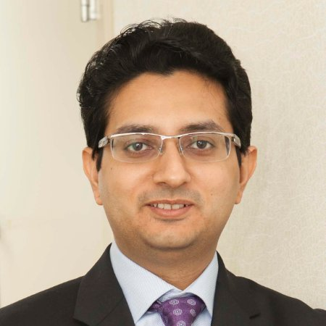
(NOTE: PASTE IN PHOTO AND SEND BEHIND FOREGROUND GRAPHIC FOR CROP)
Achievements
AWS DevOps, Healthcare, and Life Sciences Competencies
TechTarget’s “Impact Best AWS Consulting Partner” two years in a row (2015 & 2016)
Partner Recognition Award by AWS at reInvent 2015
Customers featured on stage at AWS re:Invent three years in a row
Docker Foundation and authorized consulting partner
150+ happy customers through word of mouth
Aater Suleman
Co-Founder & CEO Flux7
Faculty, University of Texas at Austin
Flux7: Cloud and DevOps Solutions
Founded in 2013
Team of 35+
Headquartered in Austin, Texas
Notes:
About Flux7 & Aater

Slide 4
(NOTE: PASTE IN PHOTO AND SEND BEHIND FOREGROUND GRAPHIC FOR CROP)
Engagement
Architect the solution with Fugro
Compress timelines
Transfer the Skills
Notes:
About Flux7

Slide 5
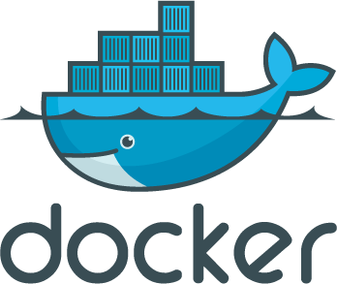
(NOTE: PASTE IN PHOTO AND SEND BEHIND FOREGROUND GRAPHIC FOR CROP)
Architect the solution with Fugro
CloudFormation
Notes:
About Flux7

Slide 6
(NOTE: PASTE IN PHOTO AND SEND BEHIND FOREGROUND GRAPHIC FOR CROP)
Timeline
Phase “0”:
Focused on designing a secure AWS environment and switching to Infrastructure as code
Phase 1:
Refined the solution by introducing Docker, Continuous integration, and Continuous Delivery
Notes:
About Flux7

Slide 7
(NOTE: PASTE IN PHOTO AND SEND BEHIND FOREGROUND GRAPHIC FOR CROP)
Flux7 Engage:
Paired up Flux7 architects with Fugro engineers
Conducted daily office hours, knowledge transfer, and debugging sessions
Notes:
About Flux7

Slide 8
Notes:
OARS Promotional Video

Slide 9
Challenges
How do we support a unique, real-time application with broadcast messages and web-sockets where some services exist together?
How do we version a web application and deploy new features in the application efficiently and globally?
How do we support future development, especially when additional micro-services might be employed?
Notes:
Outline the primary issues involved in making OARS more efficient from a DEVOPS perspective.

Slide 10
Solution
“This will be a brief moment of audience participation which should work to make things a bit more interesting for a couple of seconds.” – Captain Obvious
Notes:
We all know why we’re here. Get everyone to yell “Docker!” Then start digging deeper….

Slide 11
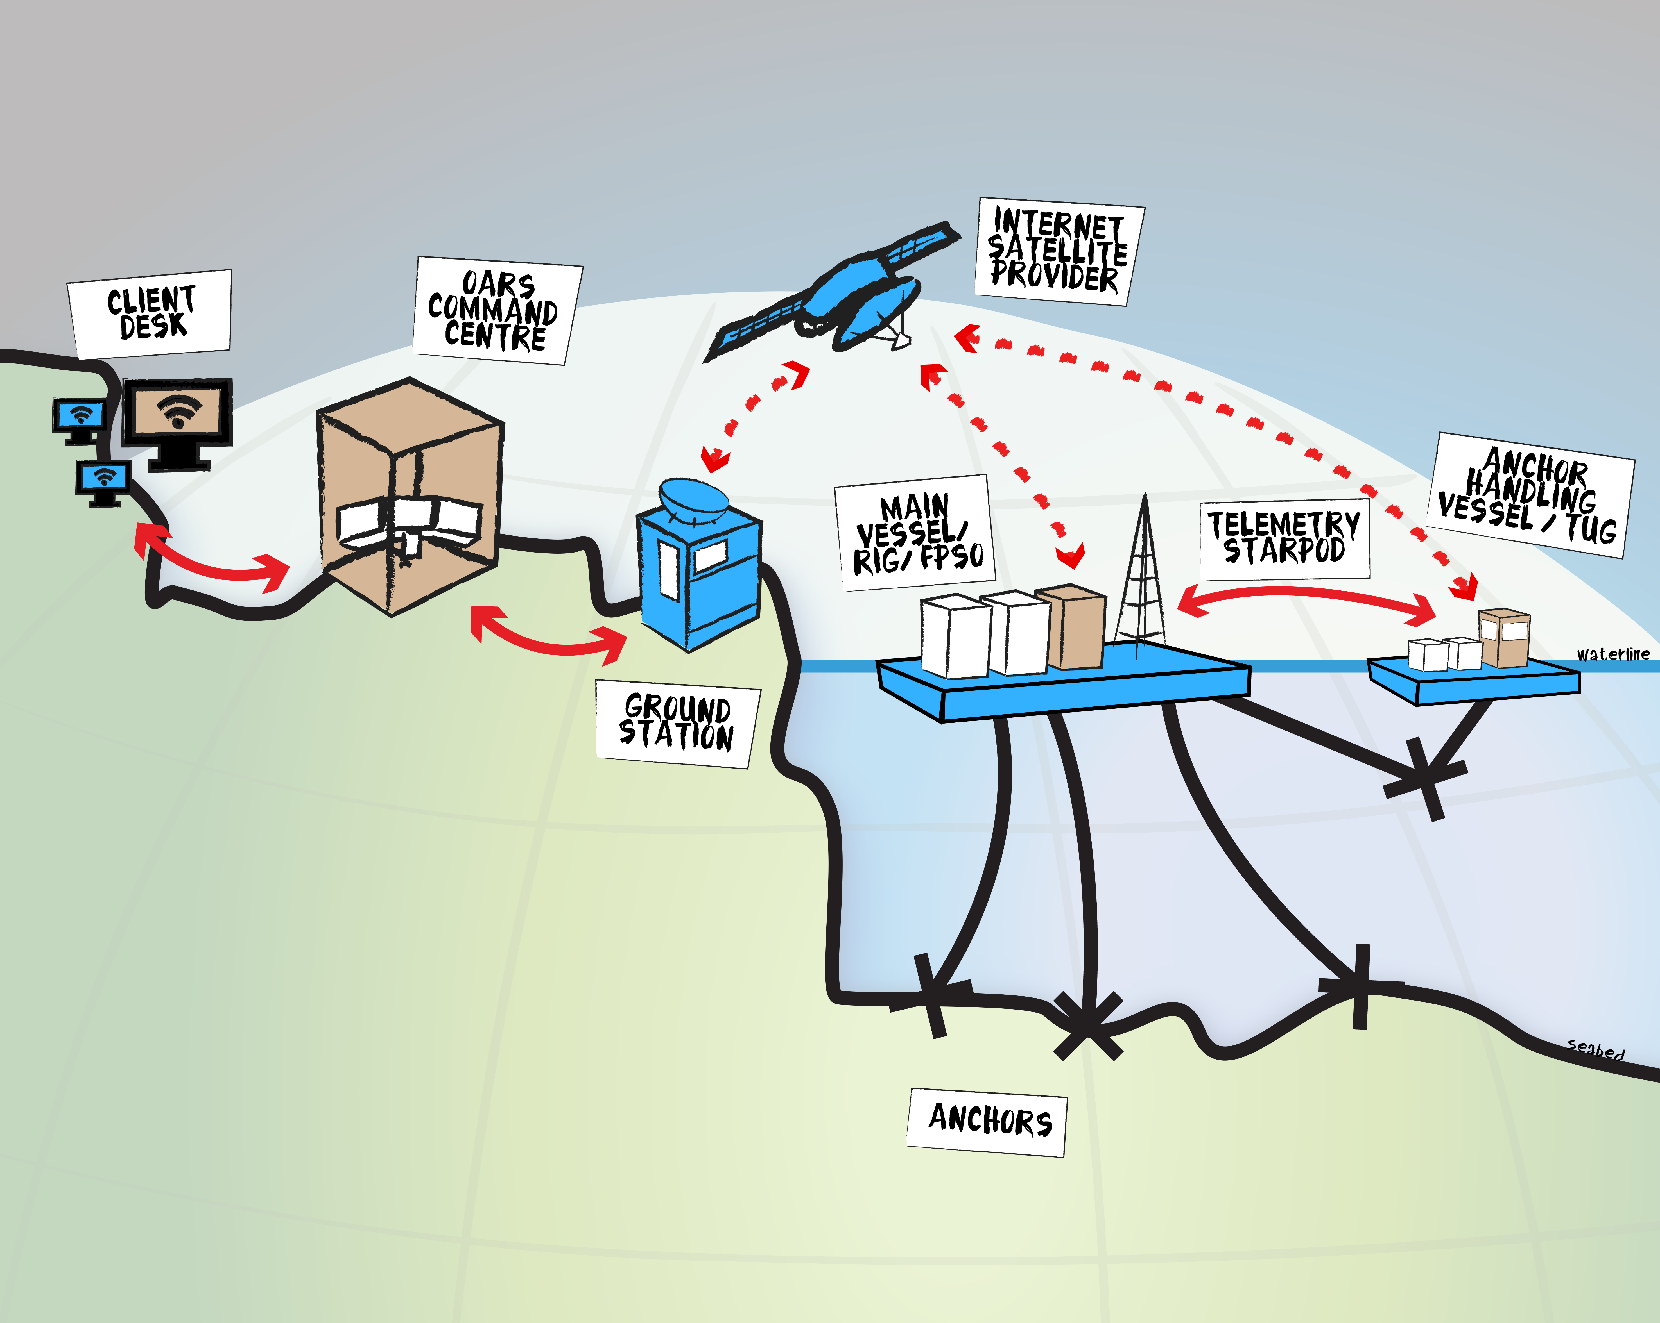
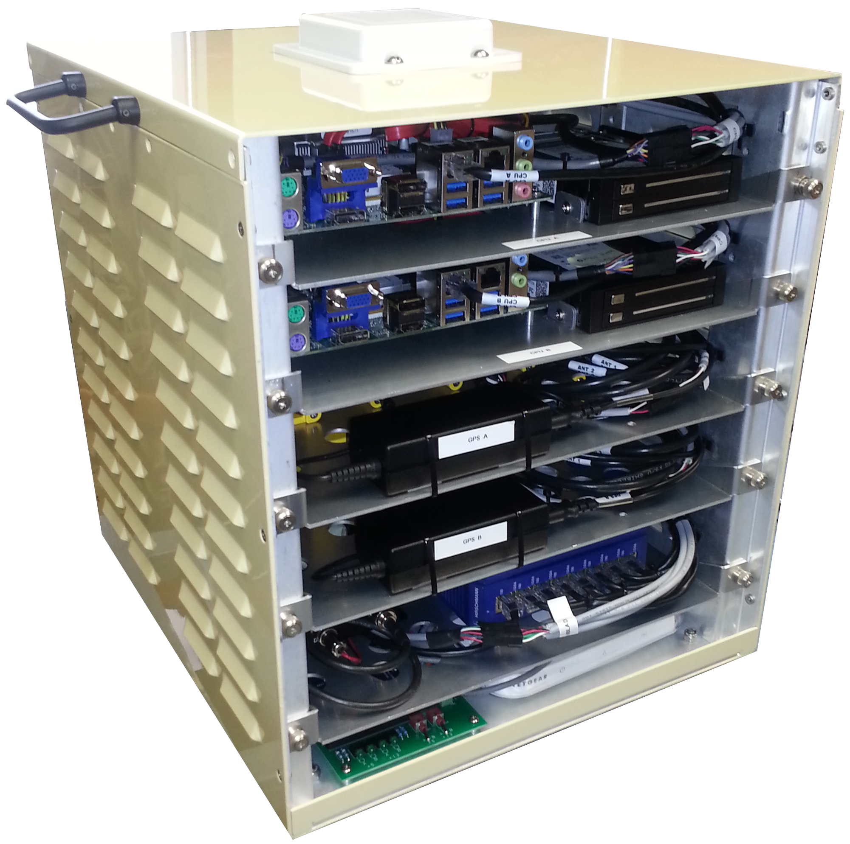
(NOTE: PASTE IN PHOTO AND SEND BEHIND FOREGROUND GRAPHIC FOR CROP)
An array of sensors are connected to an IoT device onboard each vessel which then communicates to the web based application back “on the beach” via a low-bandwidth satellite connection.
Notes:
Let’s talk about the IoT device on the vessels for a bit, without giving away the (proprietary information) farm.

Slide 12
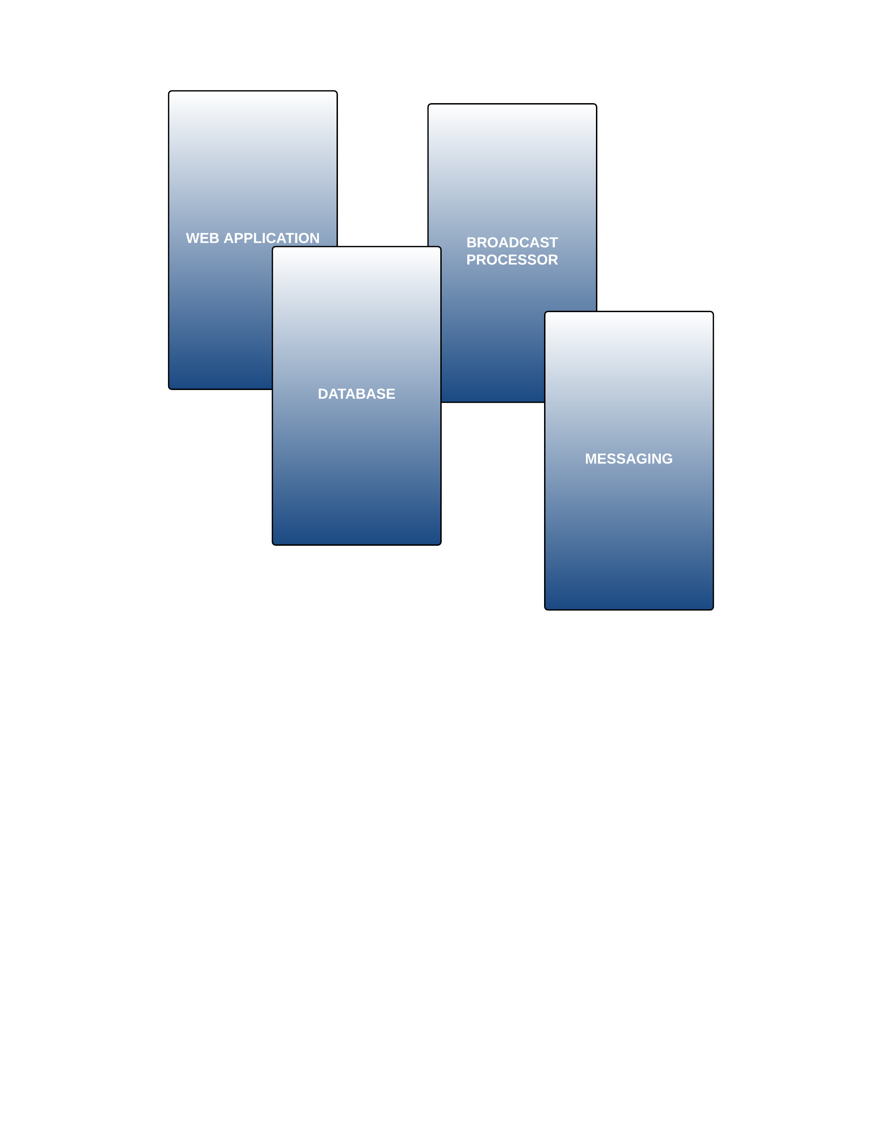
(NOTE: PASTE IN PHOTO AND SEND BEHIND FOREGROUND GRAPHIC FOR CROP)
Diverse responsibility among services leads to adopting a
micro-service architecture.
Notes:
Meanwhile, back at the beach, there is still the problem of being able to run multiple services in one container.

Slide 13
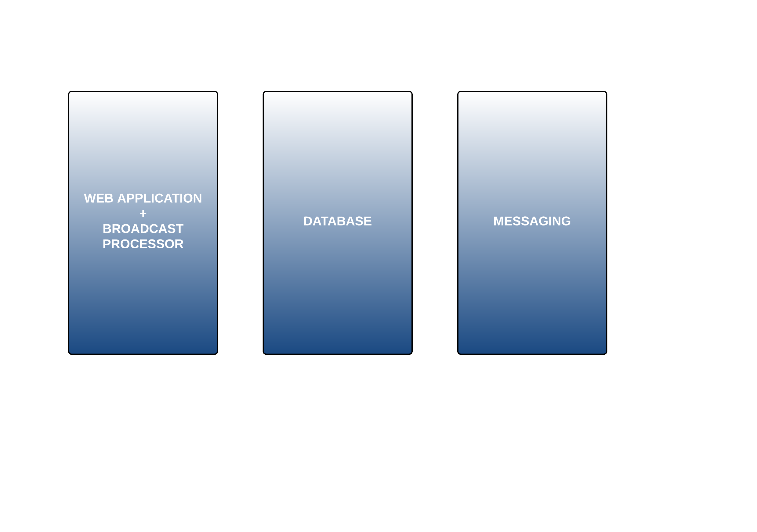
(NOTE: PASTE IN PHOTO AND SEND BEHIND FOREGROUND GRAPHIC FOR CROP)
Code, database connections and other considerations determined that two services should be run in one container.
Using SupervisorD provides a solid process to run both micro-services in the same container…
Apply SupervisorD liberally!
Notes:
There are a number of ways you can achieve this ranging from using a simple Bash script as the value of your container’s CMD instruction to installing a process management tool.
We make use of the process management tool, Supervisor, to manage multiple processes in our container. Using Supervisor allows us better management of the processes we want to run. SupervisorD doesn’t replace init on Linux systems, but it gives you a great way to manage processes related to specific projects.

Slide 14
FROM ubuntu:14.04
MAINTAINER jablanchard@fugro.com
RUN apt-get update
RUN apt-get install -y apache2 supervisor php5 php5-mysql php5-cli
RUN mkdir -p /var/lock/apache2 /var/run/apache2 /var/log/supervisor
RUN a2enmod rewrite
RUN a2enmod ssl
COPY supervisord.conf /etc/supervisor/conf.d/supervisord.conf
COPY applog /etc/logrotate.d/applog
COPY socket_log /etc/logrotate.d/socket_log
COPY udp_log /etc/logrotate.d/udp_log
ADD 000-default.conf /etc/apache2/sites-enabled/
ADD default-ssl.conf /etc/apache2/sites-enabled/
ADD apache2.conf /etc/apache2/
ADD www-server/ /www-server/
EXPOSE 80 443 30089
CMD ["/usr/bin/supervisord"]
Notes:
When the container is run the Dockerfile calls the Supervisor executable.

Slide 15
[supervisord]
nodaemon=true
[program:apache2]
command=/bin/bash -c "source /etc/apache2/envvars && exec /usr/sbin/apache2 -DFOREGROUND"
[program:broadcaster]
command=bin/bash -c "exec /usr/bin/php -f /www-server/services/broadcast_processor.php"
supervisord.conf
Notes:
Each service gets its commands and options. The configuration file is read and processed by Supervisor, starting each process as described.

Slide 16
(NOTE: PASTE IN PHOTO AND SEND BEHIND FOREGROUND GRAPHIC FOR CROP)
Notes:
How do we get our Docker based applications out to the end-user?

Slide 17
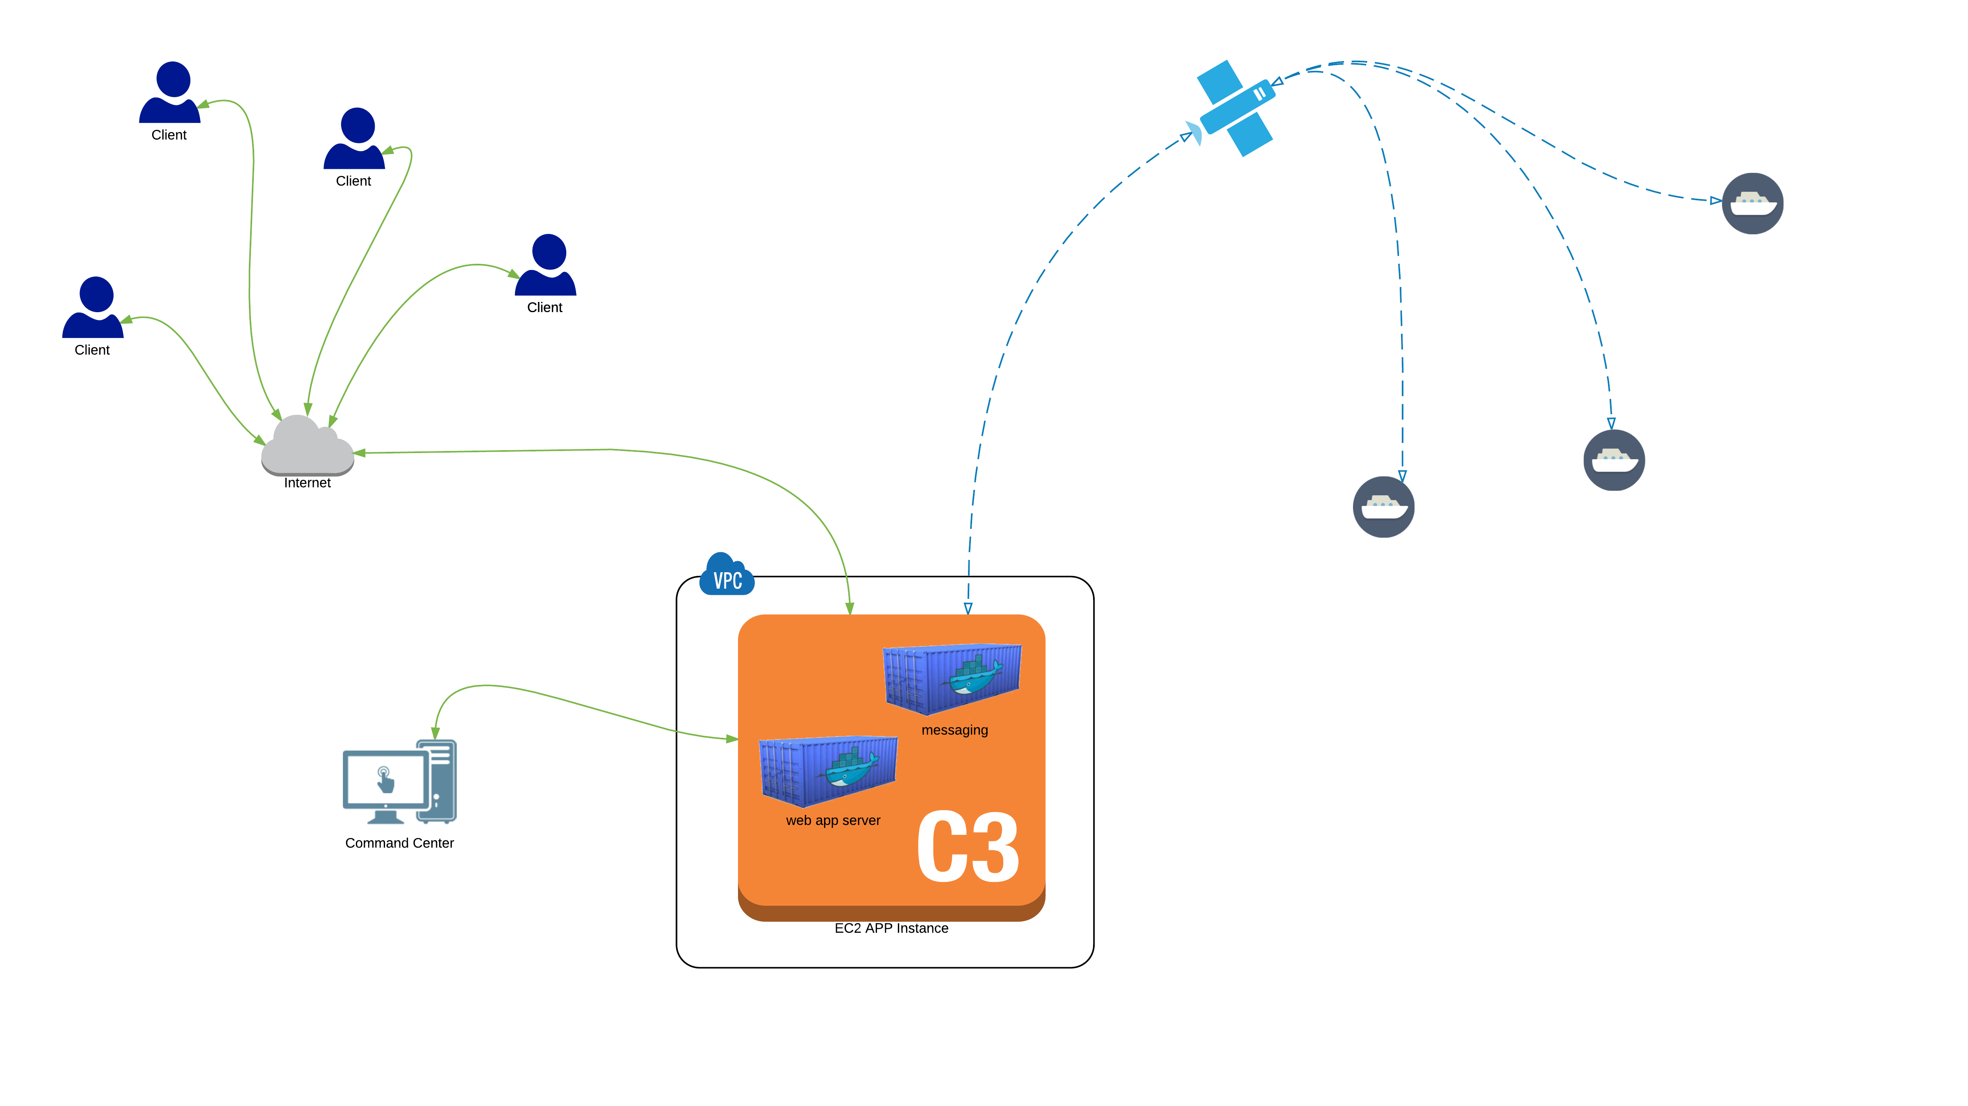
(NOTE: PASTE IN PHOTO AND SEND BEHIND FOREGROUND GRAPHIC FOR CROP)
Notes:
First we decided that world-wide deployment would be better suited for AWS Cloud Network. It is appropriate that Docker is represented as shipping containers.

Slide 18
(NOTE: PASTE IN PHOTO AND SEND BEHIND FOREGROUND GRAPHIC FOR CROP)
web app server
web app server
REPOSITORY TAG IMAGE ID CREATED VIRTUAL SIZE
picklejuice/gateway dev 2380a6273d20 3 days ago 851.9 MB
picklejuice/gateway 3.14.1-1.0.2-118 2380a6273d20 3 days ago 851.9 MB
picklejuice/gateway 3.14.0-1.0.2-117 c6fcd4fb28c8 3 days ago 839.4 MB
picklejuice/gateway test-image 59a4e1392d50 4 days ago 339.9 MB
picklejuice/gateway 3.11.0-1.0.2-116 8ef06a3cff21 7 days ago 777 MB
picklejuice/gateway 3.10.2-1.0.2-115 2da2807c4ecf 7 days ago 764.5 MB
picklejuice/gateway 3.10.0-1.0.2-114 cb9453a4ab9e 10 days ago 739.6 MB
picklejuice/gateway 3.8.0-1.0.2-113 9f39248452a3 10 days ago 714.7 MB
picklejuice/gateway 3.5.0-1.0.2-112 c1526c434b85 2 weeks ago 677.3 MB
Notes:
Developers work from code repos for the application and then use a build script into which they can designate versions and build numbers for the application. These images get pushed to a private repo on DockerHub. All of this can be done from the command line on the build server or through a set of web interfaces.

Slide 19
(NOTE: PASTE IN PHOTO AND SEND BEHIND FOREGROUND GRAPHIC FOR CROP)
web app server
web app server
Notes:
Docker containers are tagged (dev, staging prod) according to their destination VPC (DEV, STAGING, PROD). Those destined for PROD will be deployed in all production VPC's located in geographic zones e.g., Virginia, Aberdeen, etc. It is containers tagged in this way which Jenkins has AWS CodeDeploy seek out when running through the cycle.

Slide 20
“How does this make future development easier?”
— Moby

Slide 21
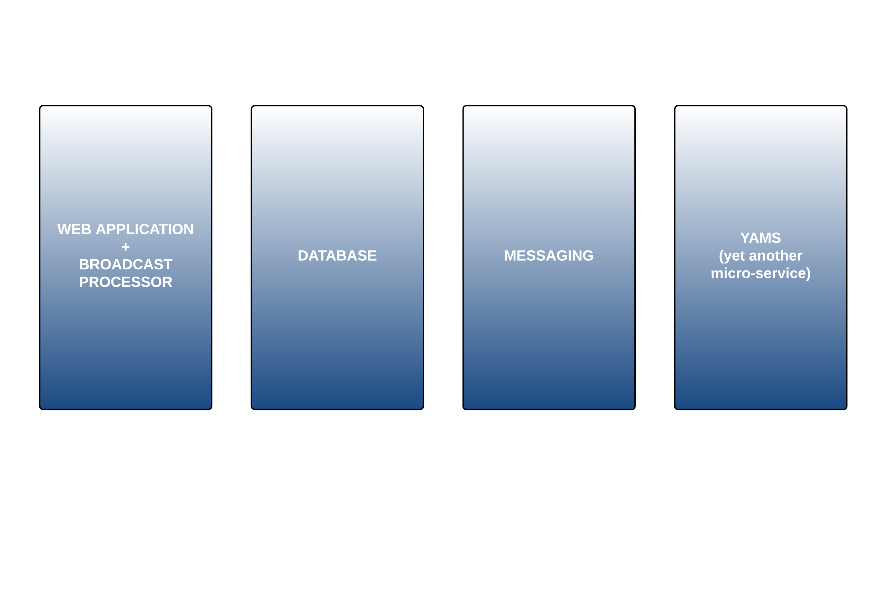
(NOTE: PASTE IN PHOTO AND SEND BEHIND FOREGROUND GRAPHIC FOR CROP)
Additional micro-services can be run in their own containers and plugged into the application “black box” style,
perhaps only exposing the ports necessary to interact with the existing micro-services or by running independently of the primary application.
Notes:
Adding more services becomes easy as all you need is a container and perhaps a way to communicate with other containers.

Slide 22
Takeaways
Supporting a unique, real-time application where some micro-services exist together is easily done with Docker using SupervisorD.
Versioning a web application is easily accomplished with tagged Docker images. We can deploy new features in the application efficiently and globally by distributing the images via our continuous delivery mechanism.
Future development is easily supported by adding micro-services in Docker containers.
Notes:
Outline the primary takeaways involved in making OARS more efficient from a DEVOPS perspective.

Slide 23
Thank you!
E-Mail: jablanchard@fugro.com
Twitter: @jaylblanchard

